Slide 1
JOURNAL CLUB
Proactive neonatal treatment
at 22 weeks

Slide 2
Objectives
Review a systematic review and meta-analysis of outcomes at 22 weeks
Describe the changing clinical landscape for the care and outcomes of infants born at 22-23 weeks’ gestation.
Identify important areas of uncertainty in the care of infants born ≤23 weeks’ gestation that require further research

Slide 3
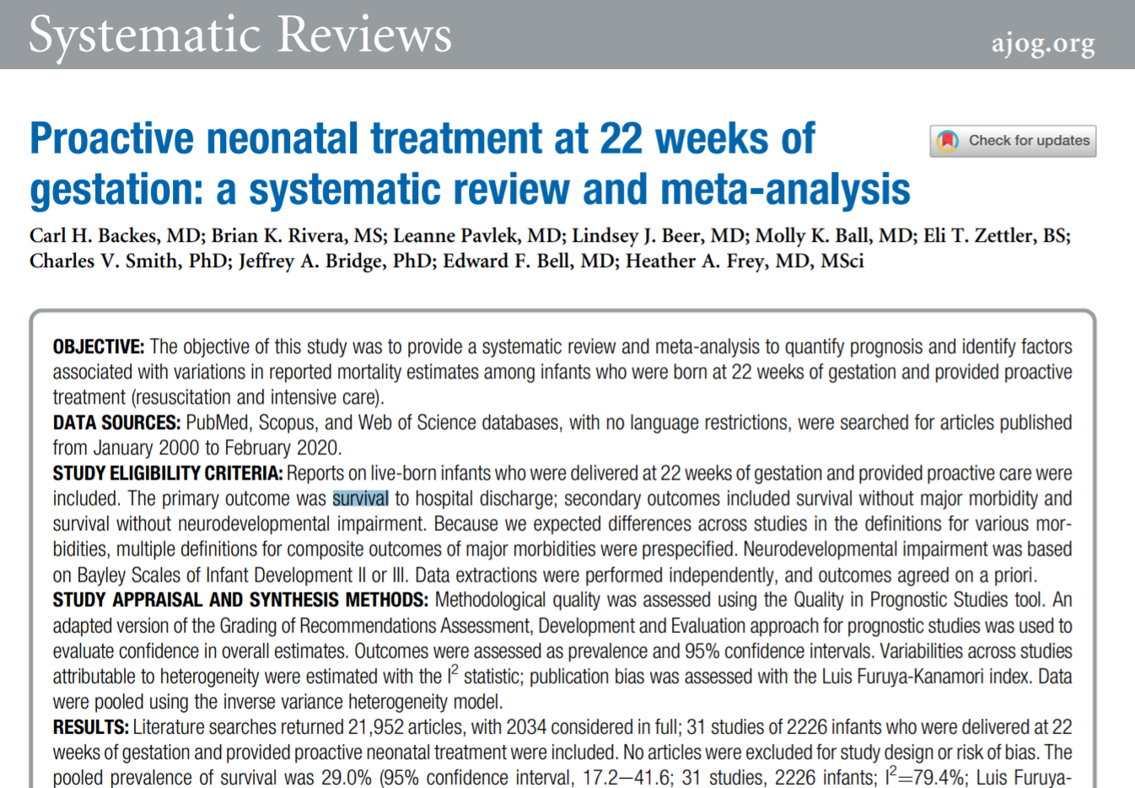

Slide 4

Neonatologists
Academic generalists
Community generalists
Maternal-fetal medicine

Slide 5
Study design
Systematic review Research of research
& &
Meta-analysis Merge findings of similar studies
Objective:
                Quantify prognosis of infants who were resuscitated and treated in NICU after birth at 22 weeks of gestation
  Identify factors associated with variations in reported mortality estimates

Slide 6
Methods
Study eligibility criteria:
Patients were live-born infants who were delivered at 22 weeks of gestation
Patients were provided proactive care (NRP and NICU)
Primary outcome: survival to hospital discharge
Secondary outcomes:
Survival without major morbidity (multiple definitions pre-specified)
Survival without neurodevelopmental impairment (Bayley Scales II or III)
Quality and stats:
Quality in Prognostic Studies tool, GRADE
I² statistic, Luis Furuya-Kanamori index, inverse variance heterogeneity model
Notes:
Definition of active treatment: ANY of endotracheal intubation, face mask ventilation, nasal continuous positive airway pressure, chest compressions, or epinephrine administration
Excluded: provided comfort care or those who did not receive proactive treatment were excluded, in order to get at the babies getting these things but not for survival
Comprehensive treatment was defined as the provision of antenatal corticosteroids (ACS) and proactive neonatal care
Studies that reported NICU admissions but excluded delivery room deaths were excluded unless reviewers could tell that proactive treatment was provided in the delivery room (opacity)
Studies that described multiple approaches were included if individual group outcomes were reported
All reproductive losses (IUFD, SAB, EAB) were excluded.
Anomalous babies were excluded
GA had to be determined by a way other than by neonatal examination and included 22w0d

Slide 7
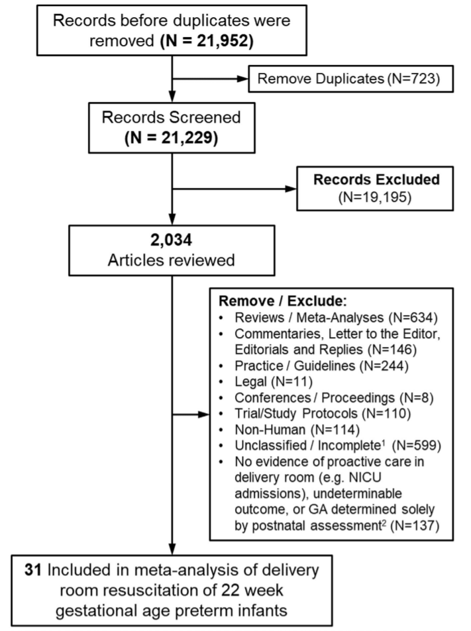
Study selection
2 authors reviewed all abstracts
All papers were reviewed (incl. translation)
1 additional author arbitrated disputes
2 authors assessed article quality independently
Standardized form was used to collect
Articles were combed for design and data:
Setting
Resuscitation policy
Time period
Notes:
The authors allowed for secular trends:
potential changes in survival over time, the cohort was divided into 2 epochs: epoch 1 (before 2010) and epoch 2 (2010e2020).
The uathors grouped study locales:
: (1) single referral hospital, (2) multihospital or multicenter network, and (3) geographically defined (eg, community and referral hospitals, births outside of hospitals)
Resusc policy:
(1) universal resuscitation (eg, consistent policy of resuscitation), (2) shared decision (eg, treatment based on parental decision in consultation with the healthcare team), and (3) nonresuscitation (eg, a policy that encouraged nonresuscitation) or undetermined (eg, studies from multicenter networks with highly variable approaches).

Slide 8
Outcome selection
Patients were asked about meaningful outcomes:
            Will my baby survive?
    If my baby survives, will she or he be able to see?
    If my baby survives, will he or she have brain problems?
    Will my baby do normal things, like go to school and play with friends?
Notes:
They also asked for outcomes about individual outcomes, such as bronchopulmonary dysplasia (BPD)

Slide 9
Outcome selection
These turned into:
Survival to hospital discharge
Survival to publication without major morbidity*
Survival to publication without major neurologic deficit**
Survival based on ACS receipt
* BPD (any grade), IVH (grade III-IV), PVL, NEC (stage 2-3 or focal with need for treatment)
** categorized as “none-mild” and “moderate-severe”
Notes:
Unfortunately, researchers planned to do Bayley II-III but had to settle for the way studies reported outcomes
Unfortunately, they wanted school-age outcomes but those were not available for these babies

Slide 10
Statistics
“inverse variance heterogeneity meta-analysis model”
they weighted studies expecting them to vary significantly, which matches the thing they’re studying
“I² statistic” and “Luis Fuyura-Kanamori indices”
they used modern methods of assessing bias inside and among the included studies
“sensitivity analysis”
they looked for why there is heterogeneity in practice and in research
“two-sided p values”
they looked at whether things they thought were good were actually bad

Slide 11
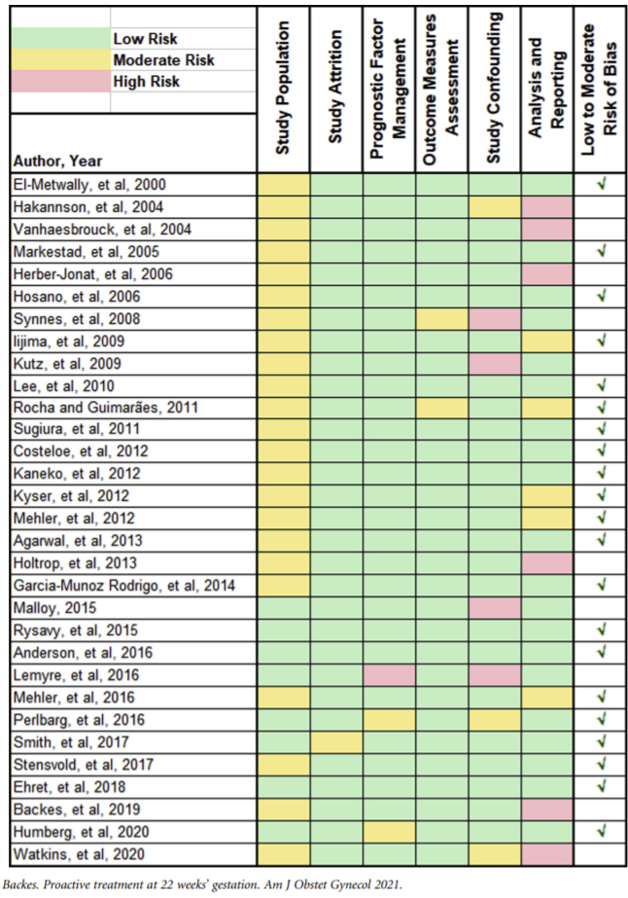
Bias
The authors in charge of rating
study bias largely agreed (K = 0.72)
10 studies were at moderate to high
risk of bias
Bias mostly stemmed from uncertainty
about whether the populations were
representative
Overall: great pool of studies!

Slide 12
Results
29.0% of 2226 infants born at 22w0d – 22w6d, in 31 studies conducted in 13 countries (US represented 10 studies)
Confidence interval: 17% to 42%
11.0% survival without major morbidity including any BPD (available in 10 studies) and 20.8% including only severe BPD
Confidence interval: 8% to 14% and 9% to 35% respectively*
37.0% survival without moderate to severe neurodevelopmental impairment
Confidence interval 14% to 62%
*Outcomes were reported very differently in each study making comparisons difficult. This is low-quality evidence.
** Very few infants (6%) could be assessed with a standardized grade (Bayley II-III). This is very low-quality evidence.
Notes:
24 of 31 studies reported only survival to hospital dc
7 studies reported survival to 1 year of age
5.5% of deaths occurred in the delivery room
Among 8 studies reporting ND outcomes beyond hospital discharge, 3 studies were not included in analysis of NDI because assessments were not conducted using BSID II or III. Of the 5 included studies with a BSID assessment, the risk of bias was moderate to low for 3 studies and moderate to high for 2 studies

Slide 13
Results
These variables impacted survival:
Universal resuscitation or individualized resuscitation
(40-43% vs 28%)
Being born after 2010
(31% vs 22%, p > 0.01)
ACS administration (39% vs 20%)*
These variables didn’t impact survival
Method of determining GA
Small vs large study
Risk of bias of the study
Study location
Source population
*Data on ACS receipt was not always reported, this finding is largely derived from 1 study
Notes:
24 of 31 studies reported only survival to hospital dc
7 studies reported survival to 1 year of age

Slide 14
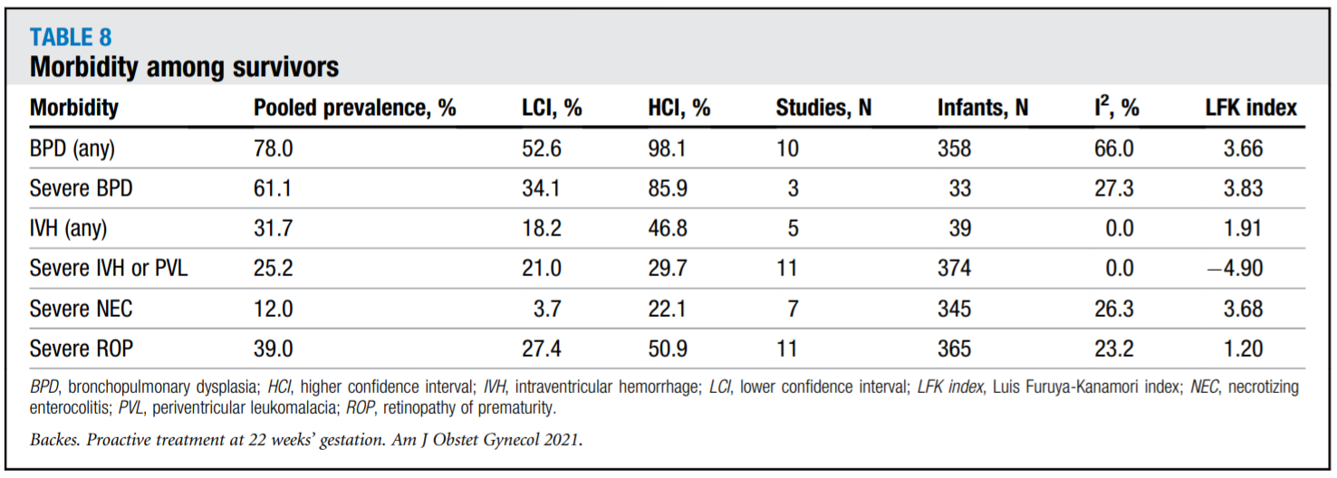
Results

Slide 15
Strengths and limitations
Strengths
Large population (2226 babies)
Robust statistical plan
Comprehensive search strategy
Transparent reporting
Limitations
Heterogeneity of reporting outcomes
Heterogeneity of patient populations
Observational studies / publication bias
Providing proactive care is not a yes/no
Including studies that did not provide proactive care to some neonates is a source of bias
*Data on ACS receipt was not always reported, this finding is largely derived from 1 study
Notes:
24 of 31 studies reported only survival to hospital dc
7 studies reported survival to 1 year of age

Slide 16
Does this fit with the literature?

Slide 17
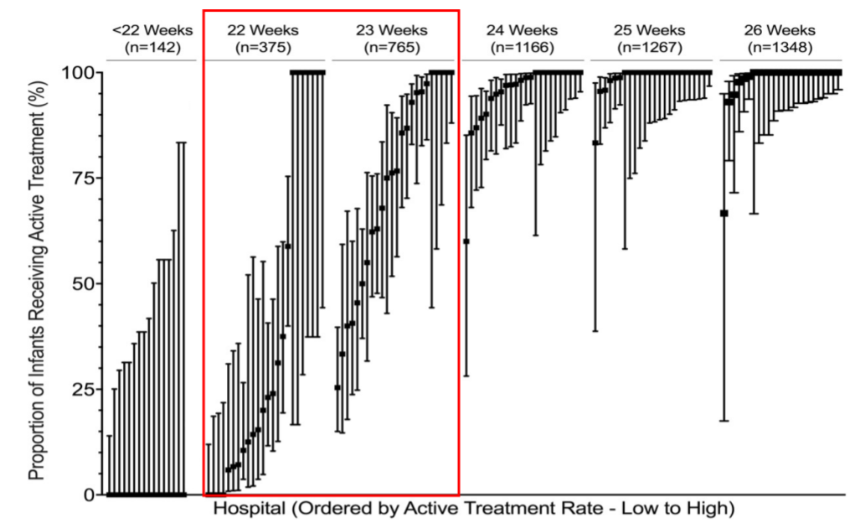
Background
1971: “The lower limit of viability is probably around 28 weeks, at which time most infants weigh two pounds, four ounces (1000 g).”
2015: NICHD data show that almost all infants above 24 weeks are treated, and many 22- and 23-weekers are treated
2019: 24.1% of 22 wk infants admitted
to a NICU survive
2020: resuscitation practices vary
(coasts, 20-22%, Midwest/south >35%)
Schaffer A, Avery ME. Diseases of the Newborn. Philadelphia, PA: Saunders; 1971
Myrhaug et al. Pediatrics. 2019
Rysavy et al. J Pediatr. 2021
Boghossian et al. Obstet Gynecol. 2020

Slide 18
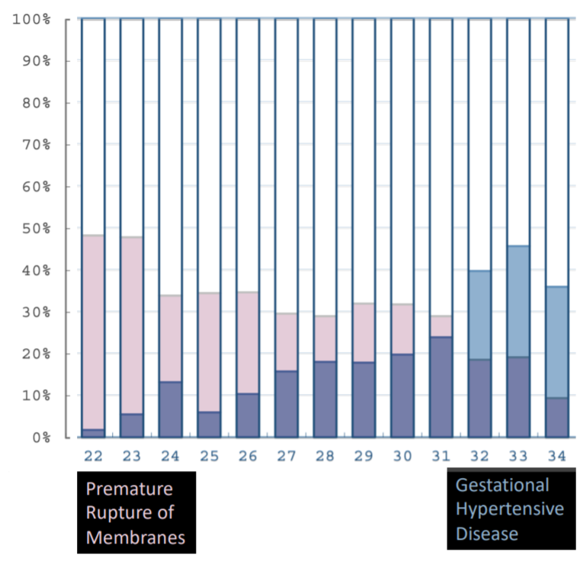
Delivery details
Delivery is for different reasons
Delivery is accomplished differently
(50% C-section rate)
Figure: Japanese Neonatal Research Network
Rysavy et al. J Pediatr. 2019

Slide 19
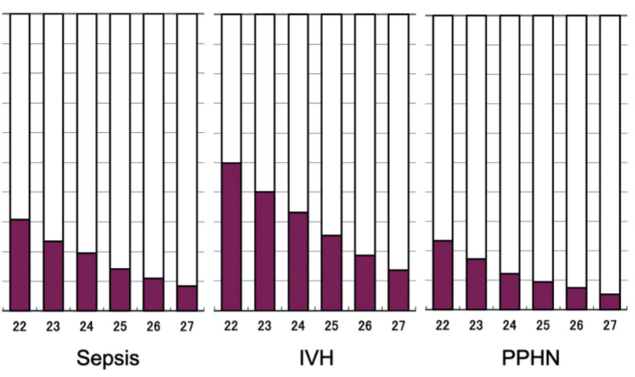
NICU course
Rates of all neonatal morbidities are
higher < 23 weeks (related to
prematurity, despite similar
steroid coverage to 23-24 weeks)
Rates of sepsis higher < 23 weeks
(related to delivery indication)
Figure: Rysavy et al. J Pediatr. 2021

Slide 20
Change in ACOG practice
“Antenatal corticosteroids may be considered at 22 0/7 weeks to 22 6/7 weeks of gestation if neonatal resuscitation is planned and after appropriate counseling.”
“The recommendation regarding antenatal corticosteroid administration at 20 0/7 weeks to 21 6/7 weeks of gestation remains unchanged: Antenatal corticosteroids are not recommended during this time period because of the absence of data to suggest benefit.”
In 2019, most (>50%) U.S. NICUs gave antenatal corticosteroids to at least 1 in 4 22-wk live births.
ACOG 2020.
Park et al. Obstet Gynecol. 2016
Ehret et al. JAMA Network Open. 2018

Slide 21
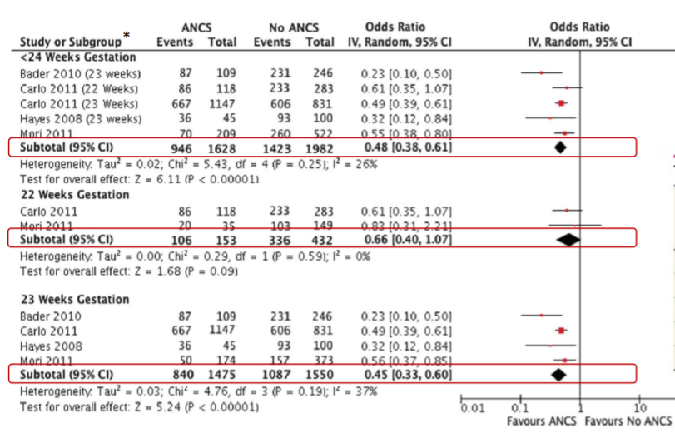
Park et al. Obstet Gynecol. 2016

Slide 22
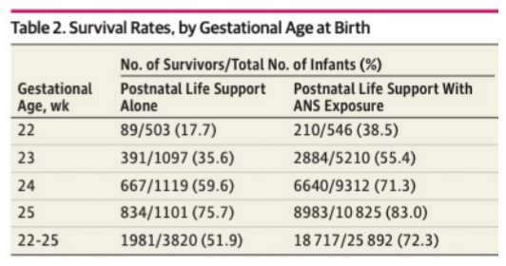
Ehret et al. JAMA Network Open. 2018

Slide 23
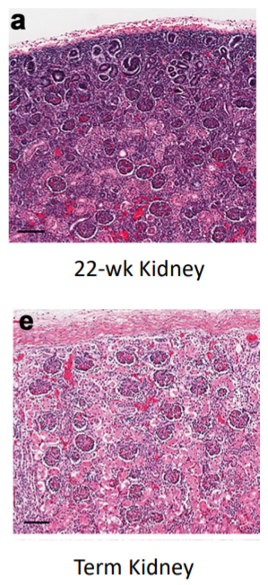
Physiology at 22 weeks
Decreased tracheal diameter, decreased vascular size
Lower alveolar count
Incomplete pulmonary artery branching
Lower nephrons density
Poorly functional adrenal cortex
Unorganized cardiac myocytes and myofibrils
Incomplete expression of adrenergic receptors
Thin epidermis, very thin stratum corneum

Slide 24
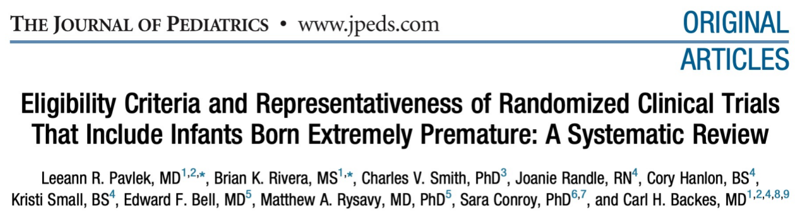

What do neonatologists know?
Notes:
From 2010-2019, 32,552 extremely preterm infants randomized in 201 RCTs • In 75 (37.3%) RCTs, infants

Slide 25
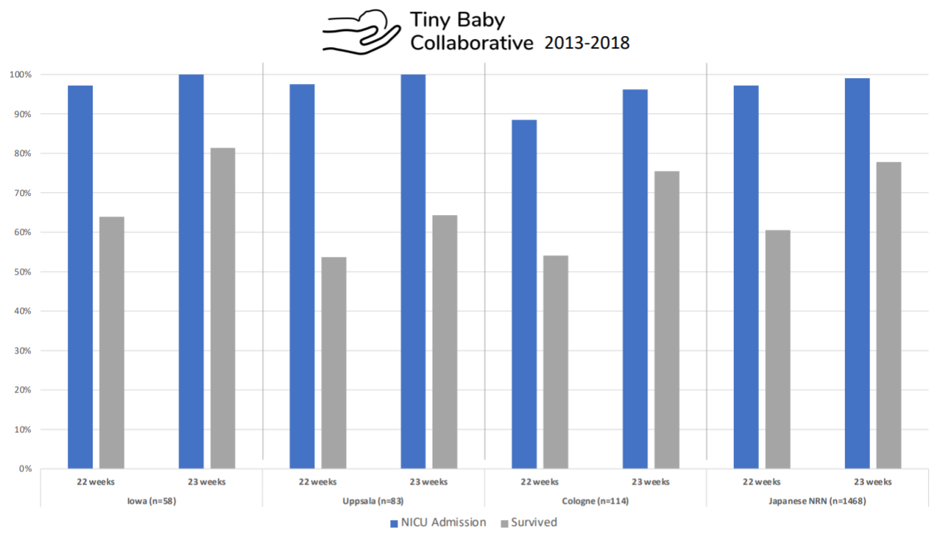
Title
Content

Slide 26
Management strategies
Culture that knows infants ≤23 weeks can do well
Partner with parents and families from the beginning
Antenatal steroids and delayed cord clamping at 22 weeks
2.0 mm endotracheal tubes
Low tidal volume ventilation
Early fungal prophylaxis
Early parenteral nutrition, maternal and donor breastmilk
Core group of doctors and nurses who have honed approach over many years
Collaboration with other specialties and hospitals
Academic approach to deviating from the status quo
Notes:
Lantos and Meadow1 describe a “selffulfilling prophecy” in the care of premature infants, wherein policies to limit treatments lead to lower survival rates; alternatively, policies to provide neonatal treatment consistently lead to greater survival rates.

Slide 27
Location matters
For a female baby born at 22 weeks, 500 g, singleton, with steroids:
      Hospital 1: 31% (CI: 23-40%)
    Hospital 2: 38% (CI: 28-50%)
    Hospital 3: 42% (CI: 34-51%)
    Hospital 4: 59% (CI: 49-68%)
…but it shouldn’t.
Vermont Oxford Network

Slide 28
Key points from the literature
22-week infants are different than other extremely preterm in important ways.
22- and 23-week infants make up 1/1000 live births and 1/7 infant deaths.
At 22 weeks, outcomes and practices vary over time and between centers.
The provision of intensive care is increasing in many places around the world. >50% of infants at 22 wk survive in some centers and national cohorts.
There is little evidence to support most specific practices, which contributes to variation.
Gestational age is not exactly the same as maturity and is not the only factor that informs prognosis.
There is substantial need to conduct better research to improve care and avoid harm in this vulnerable group of patients.

Slide 29
What can I take back to my colleagues?

Slide 30
31 good-quality studies of proactive treatment in neonates born at 22 weeks demonstrate a 29% chance of survival (CI 17-42%). Antenatal steroids doubles the survival rate (20% to 39%, p < 0.01).
Survival without major morbidity (including BPD) was 11%, and survival without moderate to severe impairment was 37% (CI 15-62%). Survival rates are on the increase and intervention and success vary drastically by center.

Slide 31
Objectives
Review a systematic review and meta-analysis of outcomes at 22 weeks
Describe the changing clinical landscape for the care and outcomes of infants born at 22-23 weeks’ gestation.
Identify important areas of uncertainty in the care of infants born ≤23 weeks’ gestation that require further research

Slide 32
JOURNAL CLUB
Proactive neonatal treatment
at 22 weeks

Slide 33
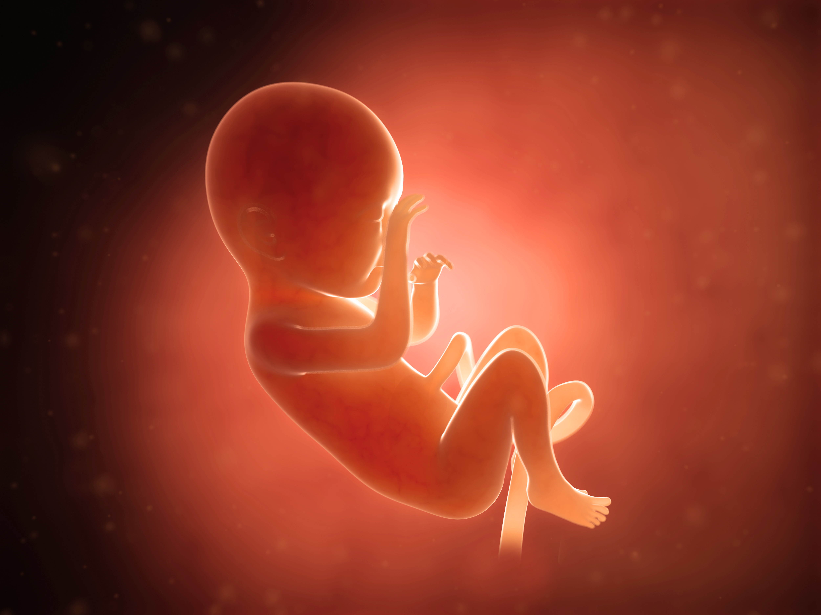

Slide 34


