Slide 1
JOURNAL CLUB
Abortion Pill Reversal

Slide 2
Objectives
Discuss a well-cited randomized controlled trial about APR.
Review background literature on APR.
Discuss practical next steps for the pro-life provider.

Slide 3
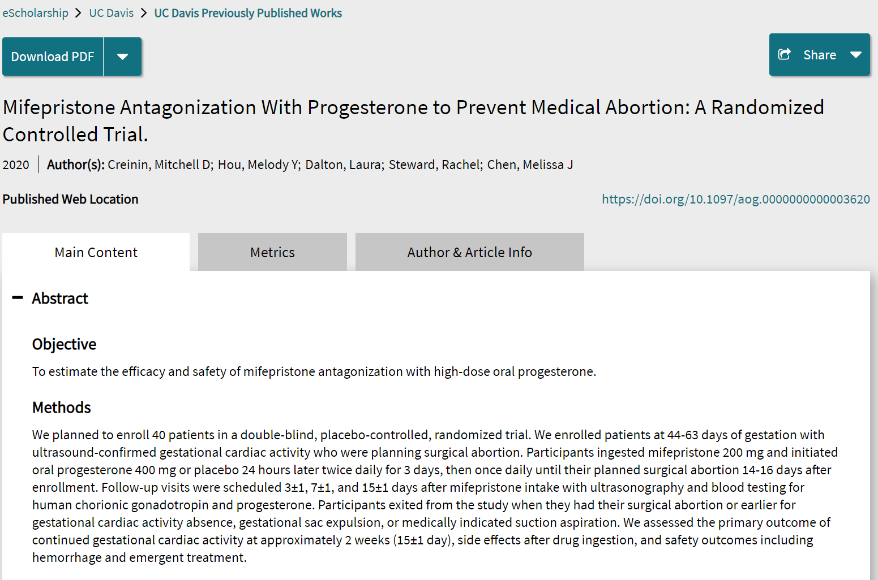

Slide 4
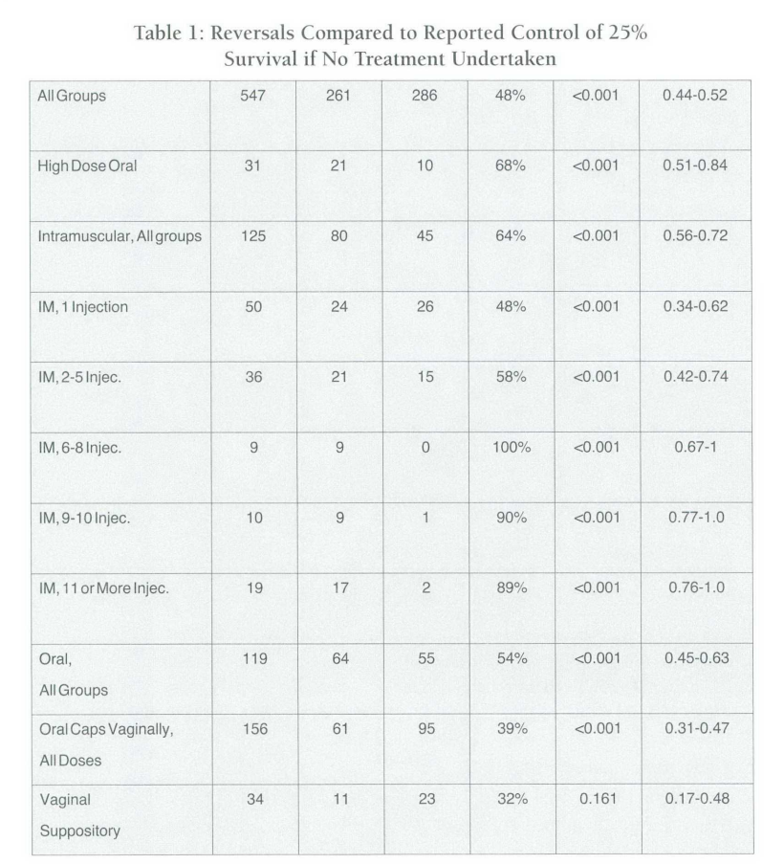
Background
247 live births / 547 APR patients (48%)
15.4% loss to follow-up rate (112 excluded for this rather than included -- ITT)
Statistically compared to population from prior studies (25%)
Delgado et al. 2018

Slide 5

Study design
Double-blind randomized controlled trial
Planned 40 patients
Population: women on GD 44-63
Intervention: oral progesterone
400mg BID for 3 days, then
once daily for 14-16 days
Comparison: placebo
Outcome: continuation of
Pregnancy until planned surgical
abortion 14-16 days later
Eligible
persons

Slide 6
Methods
Study eligibility criteria:
Women > 18 years
English-speaking
Singleton pregnancy
Willing to delay abortion by approximately 2 weeks
Exclusion criteria:
Medical contraindications to medical abortion
Allergy to mifepristone or progesterone
Peanut allergy
Notes:
Definition of active treatment: ANY of endotracheal intubation, face mask ventilation, nasal continuous positive airway pressure, chest compressions, or epinephrine administration
Excluded: provided comfort care or those who did not receive proactive treatment were excluded, in order to get at the babies getting these things but not for survival
Comprehensive treatment was defined as the provision of antenatal corticosteroids (ACS) and proactive neonatal care
Studies that reported NICU admissions but excluded delivery room deaths were excluded unless reviewers could tell that proactive treatment was provided in the delivery room (opacity)
Studies that described multiple approaches were included if individual group outcomes were reported
All reproductive losses (IUFD, SAB, EAB) were excluded.
Anomalous babies were excluded
GA had to be determined by a way other than by neonatal examination and included 22w0d

Slide 7
Methods
Primary outcome:
Continuing pregnancy with presence of gestational cardiac activity after approximately 2 weeks (15+1 days)
Secondary outcomes:
Expulsion rates over 2 weeks
Change in hCG levels during treatment
Change in progesterone levels during treatment
Progesterone side effects
Hemorrhage
Emergency department visit
Emergent suction aspiration
Notes:
Definition of active treatment: ANY of endotracheal intubation, face mask ventilation, nasal continuous positive airway pressure, chest compressions, or epinephrine administration
Excluded: provided comfort care or those who did not receive proactive treatment were excluded, in order to get at the babies getting these things but not for survival
Comprehensive treatment was defined as the provision of antenatal corticosteroids (ACS) and proactive neonatal care
Studies that reported NICU admissions but excluded delivery room deaths were excluded unless reviewers could tell that proactive treatment was provided in the delivery room (opacity)
Studies that described multiple approaches were included if individual group outcomes were reported
All reproductive losses (IUFD, SAB, EAB) were excluded.
Anomalous babies were excluded
GA had to be determined by a way other than by neonatal examination and included 22w0d

Slide 8
Methods
Sample Size Calculation:
68% continuing pregnancy rate with oral progesterone treatment
25% continuing pregnancy rate with placebo
80% power
Alpha 0.05
20 participants per group were required
Statistical Analysis:
Intention-to-treat
Frequentist statistics (Fisher’s exact test or chi-squared test as indicated, t test for continuous variables and Mann-Whitney U for comparing median values)
Notes:
Definition of active treatment: ANY of endotracheal intubation, face mask ventilation, nasal continuous positive airway pressure, chest compressions, or epinephrine administration
Excluded: provided comfort care or those who did not receive proactive treatment were excluded, in order to get at the babies getting these things but not for survival
Comprehensive treatment was defined as the provision of antenatal corticosteroids (ACS) and proactive neonatal care
Studies that reported NICU admissions but excluded delivery room deaths were excluded unless reviewers could tell that proactive treatment was provided in the delivery room (opacity)
Studies that described multiple approaches were included if individual group outcomes were reported
All reproductive losses (IUFD, SAB, EAB) were excluded.
Anomalous babies were excluded
GA had to be determined by a way other than by neonatal examination and included 22w0d

Slide 9
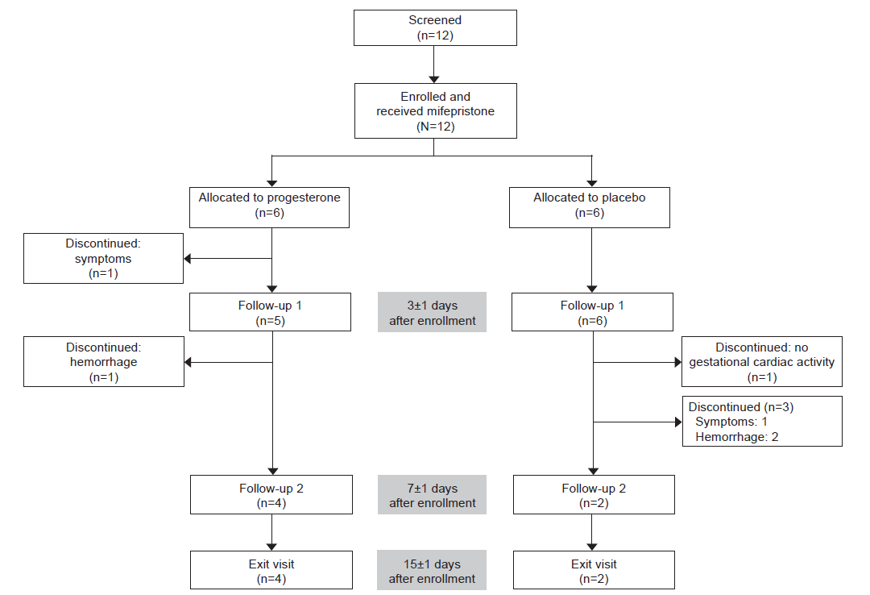
Patient Recruitment
Notes:
The authors allowed for secular trends:
potential changes in survival over time, the cohort was divided into 2 epochs: epoch 1 (before 2010) and epoch 2 (2010e2020).
The uathors grouped study locales:
: (1) single referral hospital, (2) multihospital or multicenter network, and (3) geographically defined (eg, community and referral hospitals, births outside of hospitals)
Resusc policy:
(1) universal resuscitation (eg, consistent policy of resuscitation), (2) shared decision (eg, treatment based on parental decision in consultation with the healthcare team), and (3) nonresuscitation (eg, a policy that encouraged nonresuscitation) or undetermined (eg, studies from multicenter networks with highly variable approaches).

Slide 10
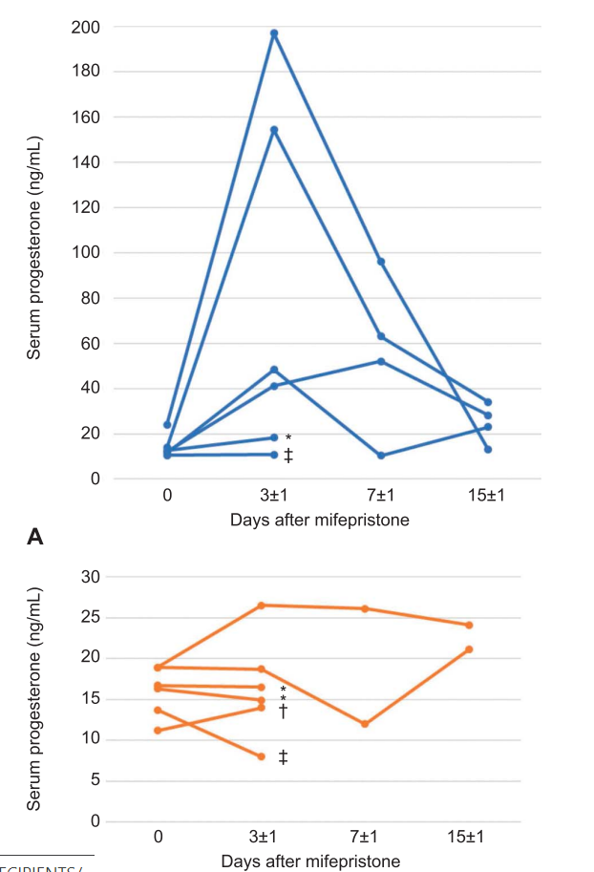
Results
12 women recruited (6 to each arm)
1 woman discontinued P for N/V
1 woman exited placebo for embryo death
1 woman had hemorrhage in P group; 2 women had hemorrhage in placebo group

Slide 11
Results
“Mifepristone without misoprostol causes hemorrhage”
“Four of six patients in the progesterone group and two of six patients in the placebo group had continuing pregnancies at 2 weeks. Excluding the two patients who did not finish treatment, these rates are four of five and two of five, respectively.”
Notes:
24 of 31 studies reported only survival to hospital dc
7 studies reported survival to 1 year of age
5.5% of deaths occurred in the delivery room
Among 8 studies reporting ND outcomes beyond hospital discharge, 3 studies were not included in analysis of NDI because assessments were not conducted using BSID II or III. Of the 5 included studies with a BSID assessment, the risk of bias was moderate to low for 3 studies and moderate to high for 2 studies

Slide 12
Hemorrhage Patient 1: Progesterone
The first patient received progesterone treatment after enrollment at 56 days of gestation. She reported no bleeding at the first follow-up visit 2 days post-mifepristone. Shortly after her visit, she started having brisk bleeding and called an ambulance. Transvaginal ultrasound examination in the emergency department found no gestational sac and a heterogenous endometrial lining of approximately 1.5 cm. Heavy bleeding lasted about 3 hours overall, and no intervention was needed.
Notes:
24 of 31 studies reported only survival to hospital dc
7 studies reported survival to 1 year of age
5.5% of deaths occurred in the delivery room
Among 8 studies reporting ND outcomes beyond hospital discharge, 3 studies were not included in analysis of NDI because assessments were not conducted using BSID II or III. Of the 5 included studies with a BSID assessment, the risk of bias was moderate to low for 3 studies and moderate to high for 2 studies

Slide 13
Hemorrhage Patient 2: Placebo
The second patient received placebo and enrolled at 60 days of gestation. She noted new mild bleeding at a followup visit 2 days after mifepristone use. The following day, she called an ambulance after onset of heavy vaginal bleeding. In the emergency department, a study physician found significant heterogenous material in the uterine cavity on ultrasound examination with continued brisk bleeding, so a suction aspiration was performed. Pathology demonstrated normal chorionic villi.
Notes:
24 of 31 studies reported only survival to hospital dc
7 studies reported survival to 1 year of age
5.5% of deaths occurred in the delivery room
Among 8 studies reporting ND outcomes beyond hospital discharge, 3 studies were not included in analysis of NDI because assessments were not conducted using BSID II or III. Of the 5 included studies with a BSID assessment, the risk of bias was moderate to low for 3 studies and moderate to high for 2 studies

Slide 14
Hemorrhage Patient 3: Placebo
The third patient also received placebo and enrolled at 60 days of gestation. She noted new mild spotting at a follow-up visit 2 days after mifepristone use. The following day, she called an ambulance after experiencing hemorrhage. In the emergency department, a study physician evaluated the patient, who had significant brisk bleeding, hypotension, and tachycardia. Transvaginal ultrasound examination showed that the gestational sac was still in the uterine cavity, so an emergent suction aspiration was performed. This patient’s hemoglobin level decreased in the emergency department from 9.2 to 7.5 g/dL, and she received a 1-unit transfusion of packed red blood cells. At safety contacts 2 and 4 weeks later, the patient reported no issues.
Notes:
24 of 31 studies reported only survival to hospital dc
7 studies reported survival to 1 year of age
5.5% of deaths occurred in the delivery room
Among 8 studies reporting ND outcomes beyond hospital discharge, 3 studies were not included in analysis of NDI because assessments were not conducted using BSID II or III. Of the 5 included studies with a BSID assessment, the risk of bias was moderate to low for 3 studies and moderate to high for 2 studies

Slide 15
Discussion
Previous case series lost >33% to follow-up, so hard to compare to literature
2/12 (25%) patients experienced hemorrhage, higher than medication abortion (0.6%)
Patients who take mifepristone should be told that not continuing (especially without progesterone) can lead to hemorrhage, although this may be less likely with progesterone
“Because of the potential dangers for patients who opt not to use misoprostol after mifepristone ingestion, any mifepristone antagonization treatment must be considered experimental.”
Notes:
They also asked for outcomes about individual outcomes, such as bronchopulmonary dysplasia (BPD)

Slide 16
Discussion
Doubt about duration of treatment
Doubt expressed over actual usefulness of P given spontaneous loss rate and the effects of not taking misoprostol:
“do those treated with placebo just expel the pregnancy earlier than those who receive progesterone but no overall long-term difference in continuing pregnancy exists?”
“We should not dismiss mifepristone antagonization as impossible; fully understanding outcomes will serve as the best means to accurately inform our patients, the medical community, and legislators.”
Notes:
They also asked for outcomes about individual outcomes, such as bronchopulmonary dysplasia (BPD)

Slide 17
Strengths and limitations
Strengths
RCT (internal validity)
Attempt at blinding
Limitations
Wrong outcome (external validity)
Wrong groups (external validity)
Sample size
Confirmation and industry bias (First author: Danco consultant; third author: affiliated with Planned Parenthood)
Notes:
24 of 31 studies reported only survival to hospital dc
7 studies reported survival to 1 year of age

Slide 18


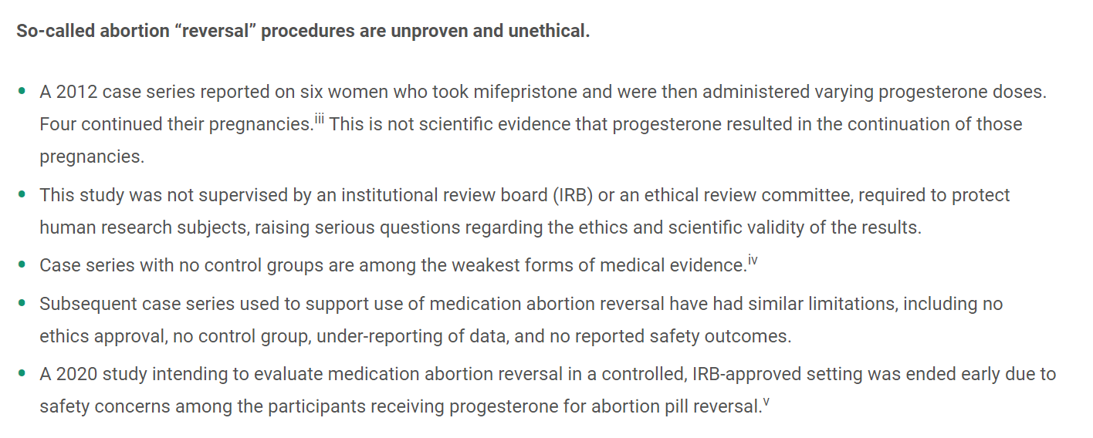
Media Outcome
Notes:
Unfortunately, researchers planned to do Bayley II-III but had to settle for the way studies reported outcomes
Unfortunately, they wanted school-age outcomes but those were not available for these babies

Slide 19
What can I take back to my colleagues?

Slide 20
What have we shown?
Mifepristone alone predisposes to hemorrhage
This is not a safe study design
Notes:
24 of 31 studies reported only survival to hospital dc
7 studies reported survival to 1 year of age
5.5% of deaths occurred in the delivery room
Among 8 studies reporting ND outcomes beyond hospital discharge, 3 studies were not included in analysis of NDI because assessments were not conducted using BSID II or III. Of the 5 included studies with a BSID assessment, the risk of bias was moderate to low for 3 studies and moderate to high for 2 studies

Slide 21
What haven’t we shown?
That APR doesn’t work
That APR is unsafe (one patient had a completed AB in the ED)
Notes:
24 of 31 studies reported only survival to hospital dc
7 studies reported survival to 1 year of age
5.5% of deaths occurred in the delivery room
Among 8 studies reporting ND outcomes beyond hospital discharge, 3 studies were not included in analysis of NDI because assessments were not conducted using BSID II or III. Of the 5 included studies with a BSID assessment, the risk of bias was moderate to low for 3 studies and moderate to high for 2 studies

Slide 22
What would be an ideal design?
External validity: show what is happening in the world
Mifepristone + misprostol vs. mifepristone + progesterone
Problem: ethics
Pro-choice side: we can’t randomize to continuation!
Pro-life side: we can’t randomize to abortion!
How can we “agree” and also measure an outcome that matters to patients?
Notes:
24 of 31 studies reported only survival to hospital dc
7 studies reported survival to 1 year of age
5.5% of deaths occurred in the delivery room
Among 8 studies reporting ND outcomes beyond hospital discharge, 3 studies were not included in analysis of NDI because assessments were not conducted using BSID II or III. Of the 5 included studies with a BSID assessment, the risk of bias was moderate to low for 3 studies and moderate to high for 2 studies

Slide 23
Matched prospective cohort
Recruit women seeking abortions
Recruit matched controls seeking APR from among women already seeking APR
Protects the autonomy of all women
Externally valid: reflects women’s current choices in society
Difficult and expensive
Notes:
24 of 31 studies reported only survival to hospital dc
7 studies reported survival to 1 year of age
5.5% of deaths occurred in the delivery room
Among 8 studies reporting ND outcomes beyond hospital discharge, 3 studies were not included in analysis of NDI because assessments were not conducted using BSID II or III. Of the 5 included studies with a BSID assessment, the risk of bias was moderate to low for 3 studies and moderate to high for 2 studies

Slide 24
Objectives
Discuss a well-cited randomized controlled trial about APR.
Review background literature on APR.
Discuss practical next steps for the pro-life provider.

Slide 25

Life. It’s why we are here.
AAPLOG.org
Communications @aaplog.org
202-230-0997

