Slide 1
JOURNAL CLUB
Cesarean Scar Ectopic Pregnancy

Slide 2
Objectives
Discuss a systematic review of management options for cesarean scar pregnancy, which concludes that globally, CSPs do not need to end in abortion.
Review an algorithm created by experts in the field of cesarean scar pregnancy, from the perspective of a pro-life physician.
Discuss other treatment options from a pro-life perspective.

Slide 3
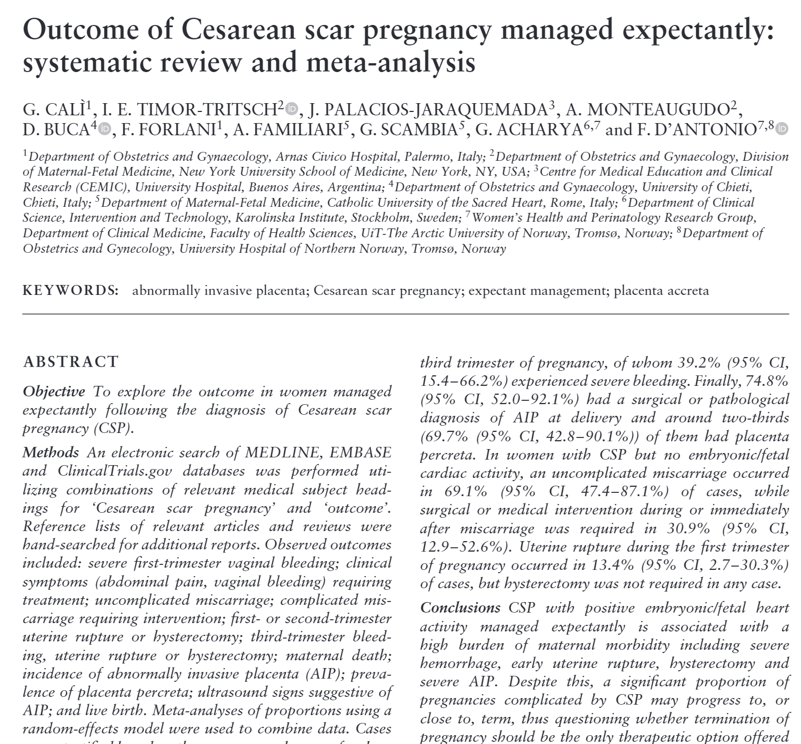

Slide 4

Gynecologists
Obstetricians
Community generalists
Maternal-fetal medicine

Slide 5
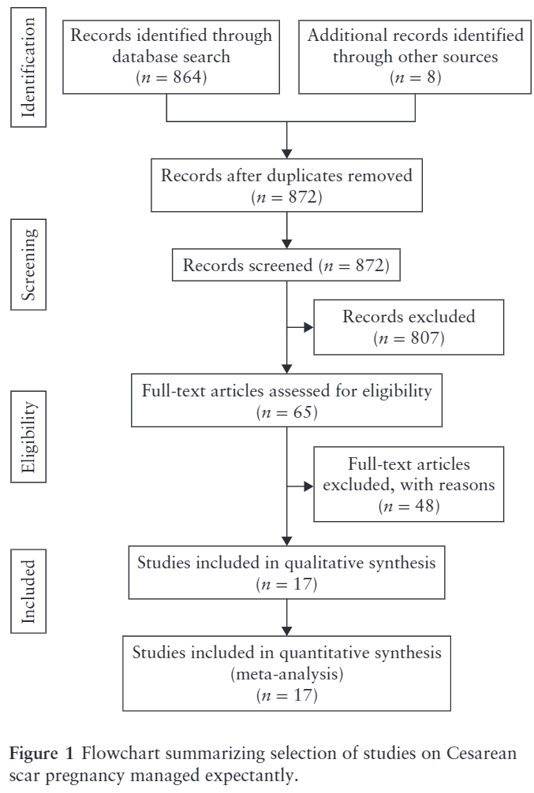
Study design
Systematic review
Meta-analysis using a random effects model, stratified by presence of embryonic/fetal cardiac activity
Evidence- and expert-guided algorithm
Cali et al UOG 2018

Slide 6
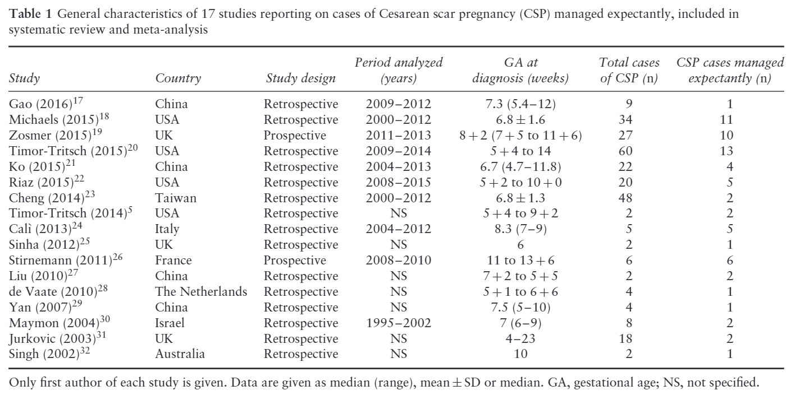
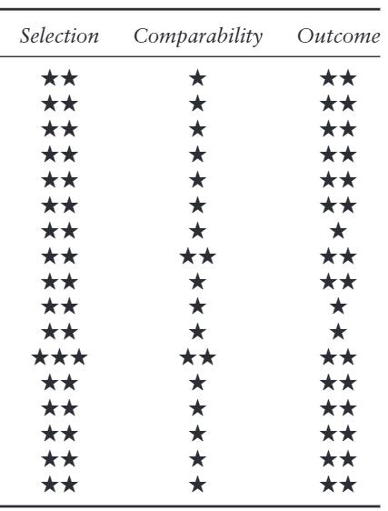
Systematic Review
Cali et al UOG 2018

Slide 7
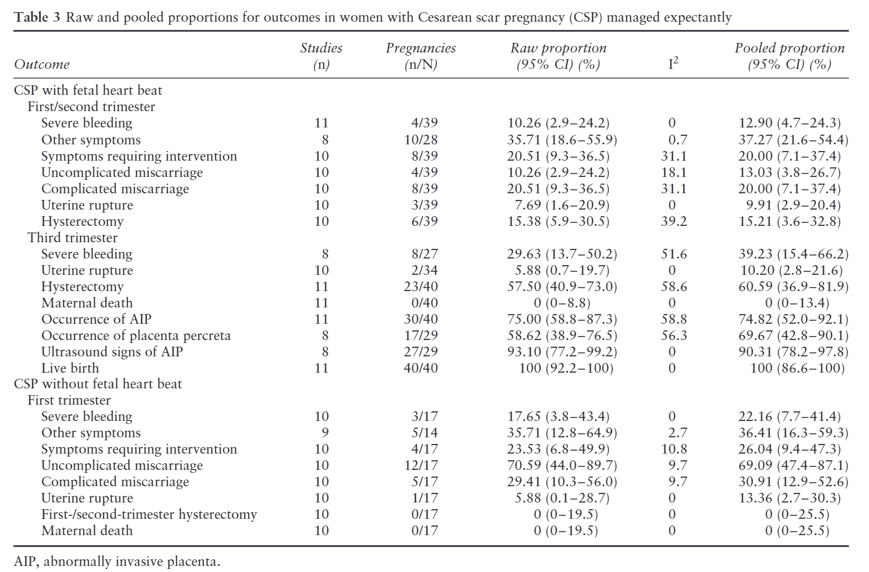
Cali et al UOG 2018

Slide 8
Expectant Management
69 / 273 women (25%) treated expectantly
52 / 69 women (75%) had positive cardiac activity at the time of diagnosis
13% had an uncomplicated miscarriage
20% had a complicated miscarriage
77% progressed into the third trimester
39% had severe third-trimester bleeding
10% had uterine rupture
75% had placenta accreta spectrum (69% percreta, 90% diagnosed prenatally)
61% needed a cesarean hysterectomy
No maternal death

Slide 9
Expectant Management
17 / 69 women had negative cardiac activity at the time of diagnosis
12 experienced an uncomplicated miscarriage
8 had symptoms, half of which required intervention, (3 were severe bleeding)
5 required surgical intervention associated with a miscarriage
1 patient had uterine rupture in the first trimester
No maternal death or hysterectomy

Slide 10
Strengths and Limitations
Strengths
Robust systematic review methodology
Data quality assessment
Good data synthesis
Best published estimate of the occurrence of adverse outcomes in women with CSP undergoing expectant management
Limitations
Limitations of included studies (retrospective design, small sample size, lack of stratification, heterogeneity)
Publication bias not assessed
Patient selection bias (not controlled or randomized)
Notes:
Lack of stratification comment: (e.g. β-hCG level, size/position of the pregnancy)
Heterogeneity comment: (gestational age at diagnosis, outcomes reported, management strategy)
Publication bias comment: Funnel plots are messy bc many studies have no expectant management (sample size 0)
Selection bias comment: most severe and symptomatic patients arelikely to have received non-expectant management.

Slide 11
Bottom Line
Expectant management without cardiac activity is safe and permissible after informed consent; b-hCG levels should be monitored until resolution (69%) or surgical management (31%).
Expectant management with cardiac activity leads to miscarriage (33%) in some women, but a third trimester delivery is more common (77%). CSP and PAS are strongly associated and the majority of patients (61%) require hysterectomy.

Slide 12
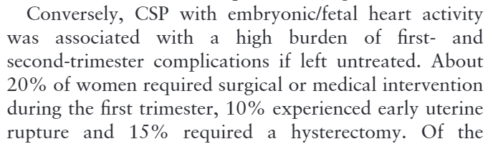
Reading Studies
28% of SAB need intervention
Nanda et al. Expectant vs surgical treatment for miscarriage. 2012. Cochrane. 10.1002/14651858.CD003518.pub3
10% uterine rupture rate
Prior classical C-section
15% hysterectomy rate
Similar to focal placenta accreta?
Cali et al UOG 2018

Slide 13
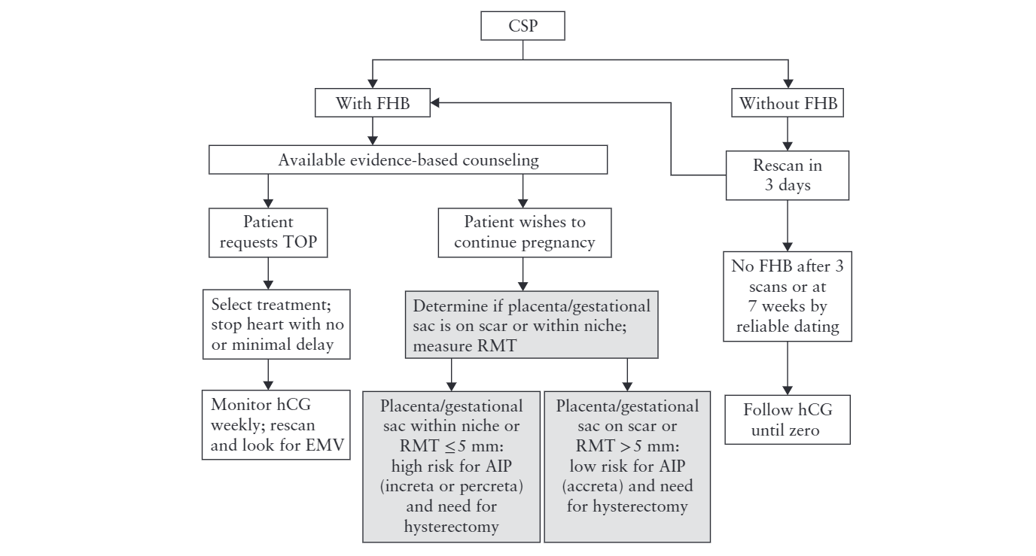
Proposed Algorithm
Cali et al UOG 2018

Slide 14
Tailoring Your Decision to the Patient
B-hCG level
Location of the gestational sac (on the scar vs into a deficient/dehiscent scar)
Residual myometrial thickness
Residual myometrial vascularity
Surgical management option(s)
Delivery setting and unit preparedness

Slide 15
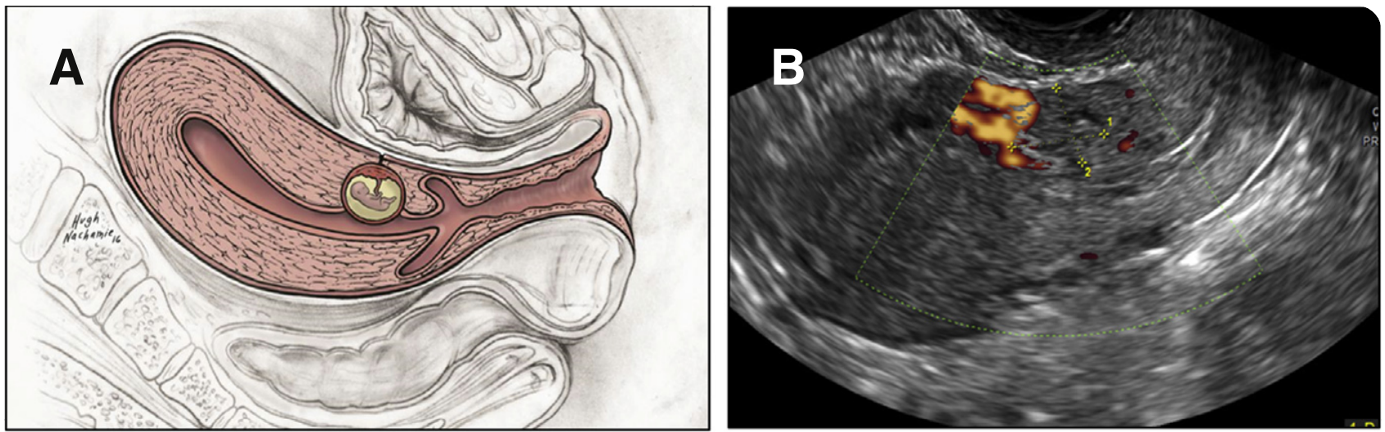
Prior Literature
CSP is defined as any implantation event on a prior C-section scar and is rising in incidence with C-sections¹
Diagnostic criteria:
GS at the site of a previous hysterotomy
Empty endometrium, empty cervix
Thin myometrium adjacent to the bladder²
1. Timor-Tritsch et al AJOG 2012
2. D’Antonio et al UOG 2016
3. Image: Timor-Tritsch AJOG 2016

Slide 16
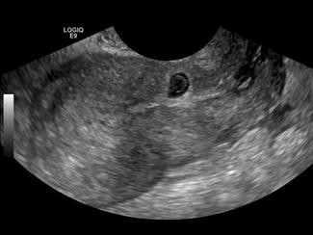
Prior Literature
CSP can lead to hemorrhage, uterine rupture, need for hysterectomy¹
Optimal approach not defined, many cause the death of the embryo or fetus¹
One review exists to comment on ethics of various options from a pro-life perspective²
CSP is on a continuum with PAS, which causes significant morbidity to women, so some authors consider TOP as only option^{3,4}
1. Birch Petersen et al Fertil Steril 2016
2. Buskmiller Linacre 2018
3. Timor-Tritsch et al UOG 2015
4. Timor-Tritsch et al UOG 2014
5. Image: Kim and Kendall Crit Ultrasound J 2011

Slide 17
Prior Literature
CSP location impacts the risk of PAS¹
CSP location on vs in/through the scar impacts affects the rate of adverse maternal outcomes²
Ethical considerations are simplified in ectopic pregnancies with nonliving embryos³
Analysis of what you should do as a pro-life physician with ectopic pregnancy largely uses the principle of double effect⁴
1. Cali et al, UOG 2017
2. Kaelin Aetgen et al AJOG 2017
3. Condic and Harrison, Linacre 2018
4. AAPLOG Practice Guideline 9 (Ectopic Pregnancy), March 2020.

Slide 18
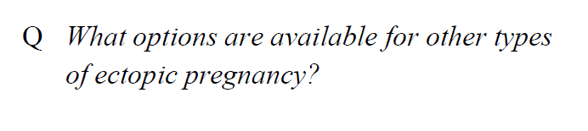
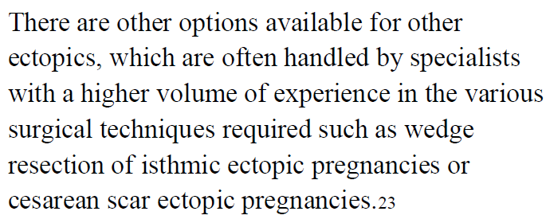
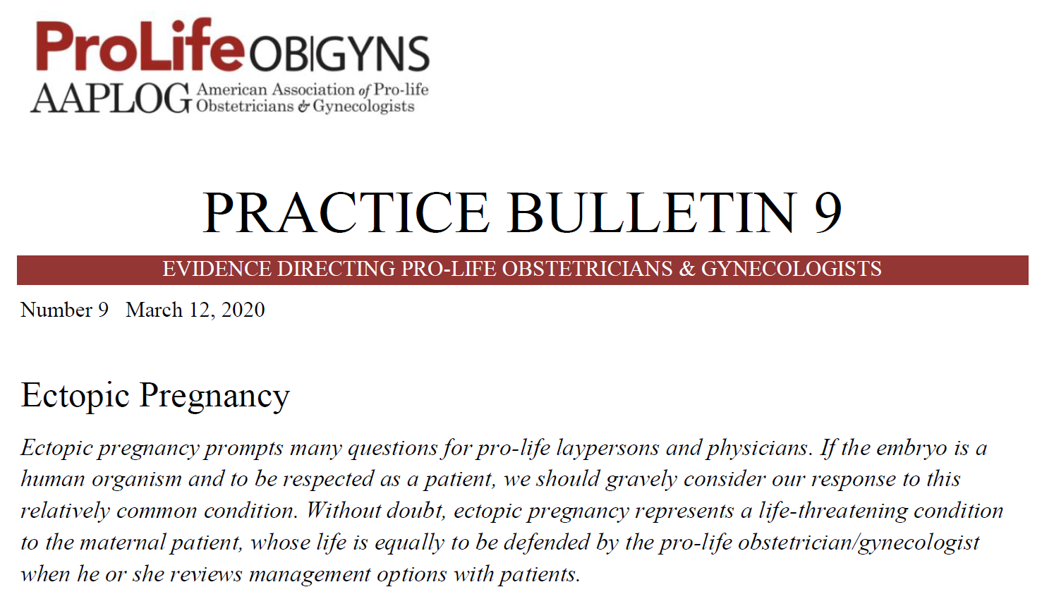
Other Literature

Slide 19
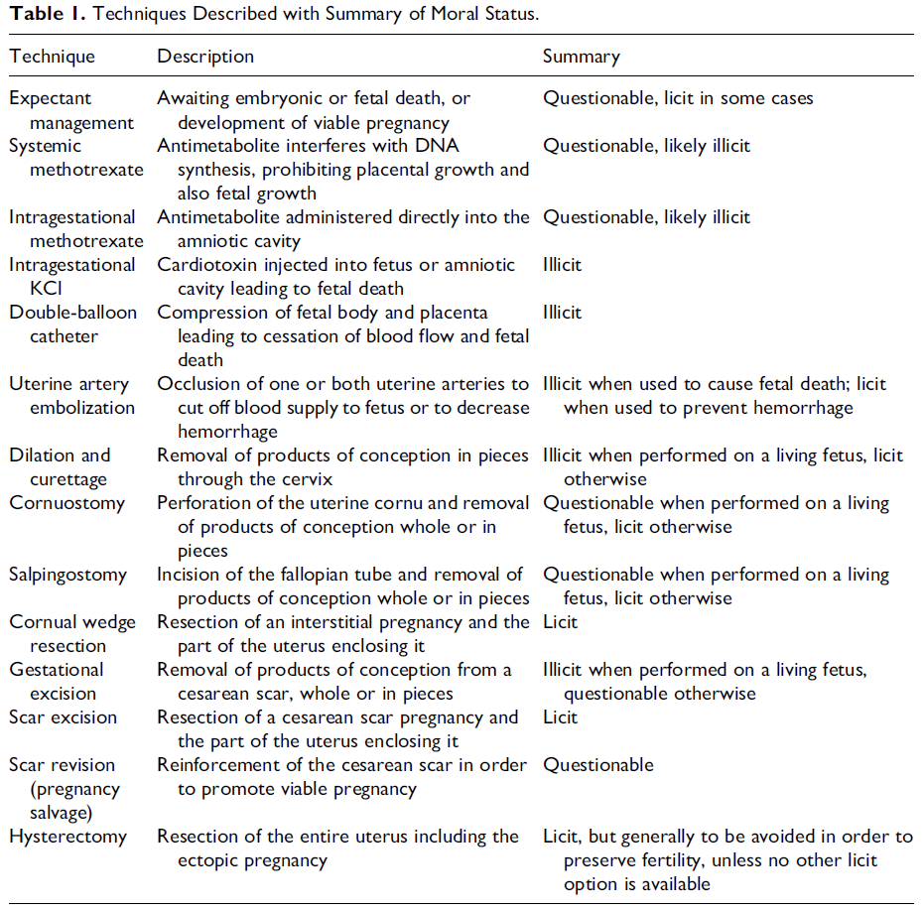
Other Treatment Options
Buskmiller Linacre 2018

Slide 20
Other Treatment Options
Hysterotomy
Buskmiller Linacre 2018

Slide 21
Case Discussions

Slide 22
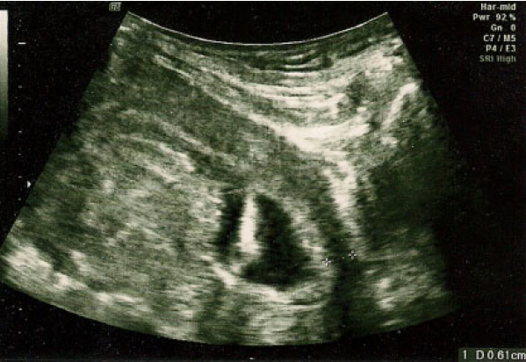
Case from Author
25 y/o G5P4, 4 prior C-sections
6 wks, called Type II CSP
Treatment chosen: systemic MTX, elevated LFTs accompanied cessation of cardiac motion
Outcome: D&C with laparoscopic guidance
Buskmiller Linacre 2018

Slide 23
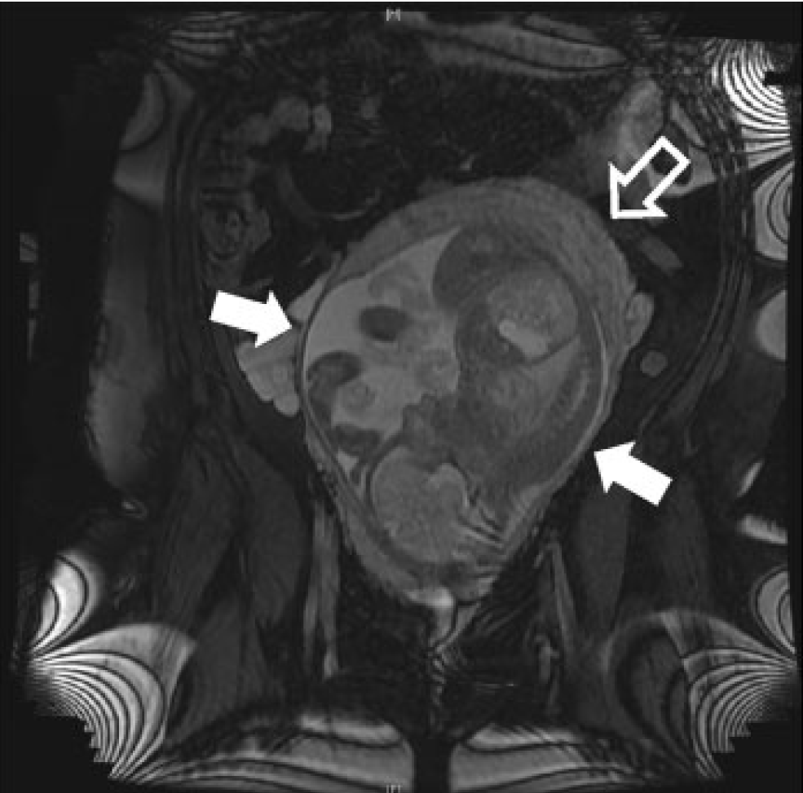
Case from Author
33 y/o G1P0100 at first trimester US
Called Type II, offered D&C w/ laparoscopic guidance
Second opinion: oversew the hysterotomy
Outcome: 31 week C-hyst with living child, after PPROM
Buskmiller Linacre 2018

Slide 24
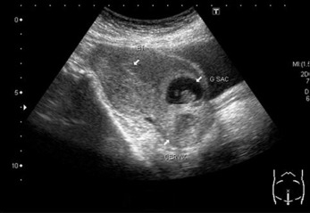
Imaginary Case
23 y/o G3P2002, two prior C-sections (breech, repeat)
7 week US as shown, + cardiac motion
How best to counsel her?

Slide 25
Objectives
Discuss a systematic review of management options for cesarean scar pregnancy, which concludes that globally, CSPs do not need to end in abortion.
Review an algorithm created by experts in the field of cesarean scar pregnancy, from the perspective of a pro-life physician.
Discuss other treatment options from a pro-life perspective.

Slide 26
JOURNAL CLUB
Cesarean Section Pregnancy (CSP)

Slide 27


Life. It’s why we are here.
AAPLOG.org
Communications @aaplog.org
202-230-0997

