Slide 1
JOURNAL CLUB
Perinatal Palliative Care

Slide 2
Objectives
Discuss a review of and expert recommendations about perinatal palliative care
List concrete parts of perinatal palliative care as an evidence-based alternative to termination of pregnancy
Share difficult or helpful clinical cases among attendees

Slide 3
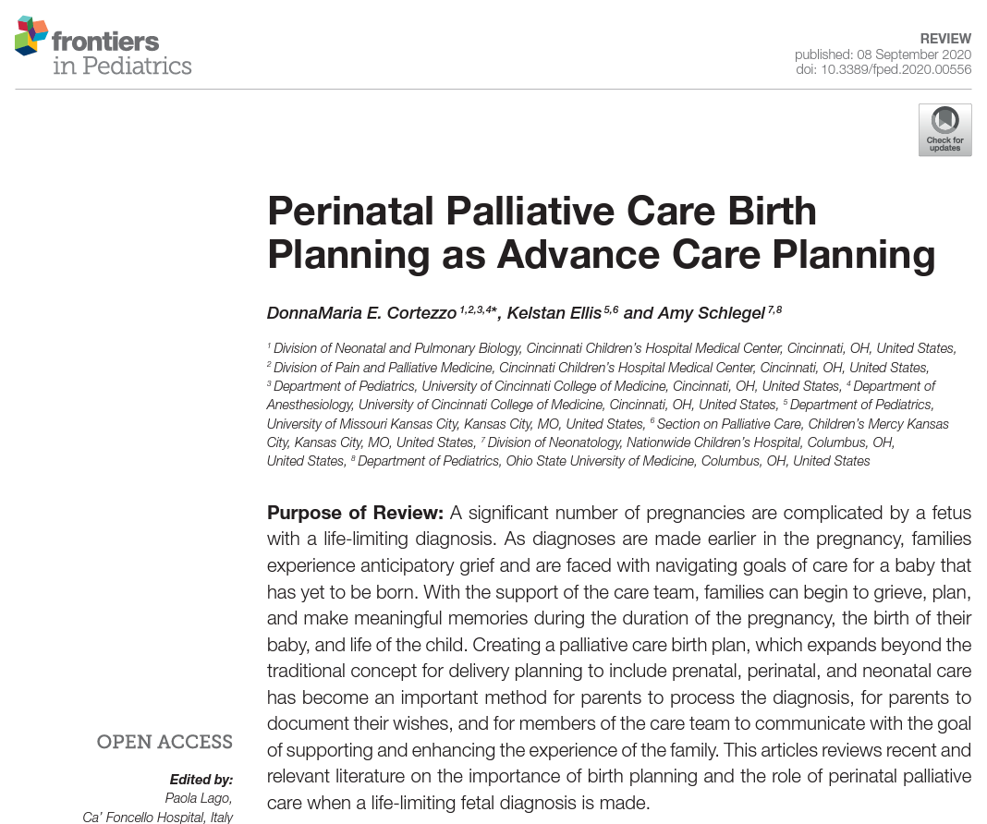

Slide 4

Neonatologists
Academic generalists
Community generalists
Maternal-fetal medicine

Slide 5
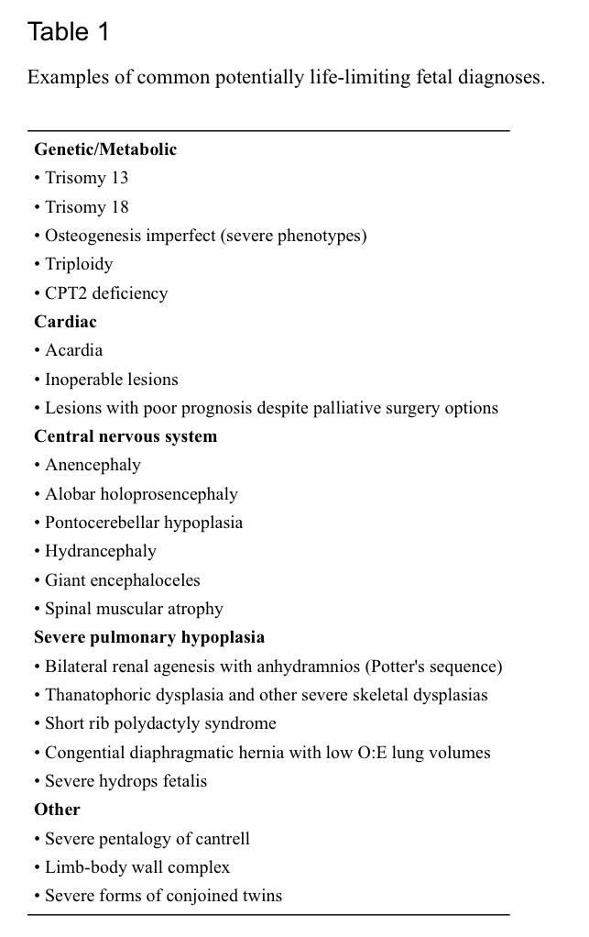
Study design
Non-systematic review
Discussion of author/expert practice patterns
Recommendations and guidance on starting perinatal palliative care

Slide 6
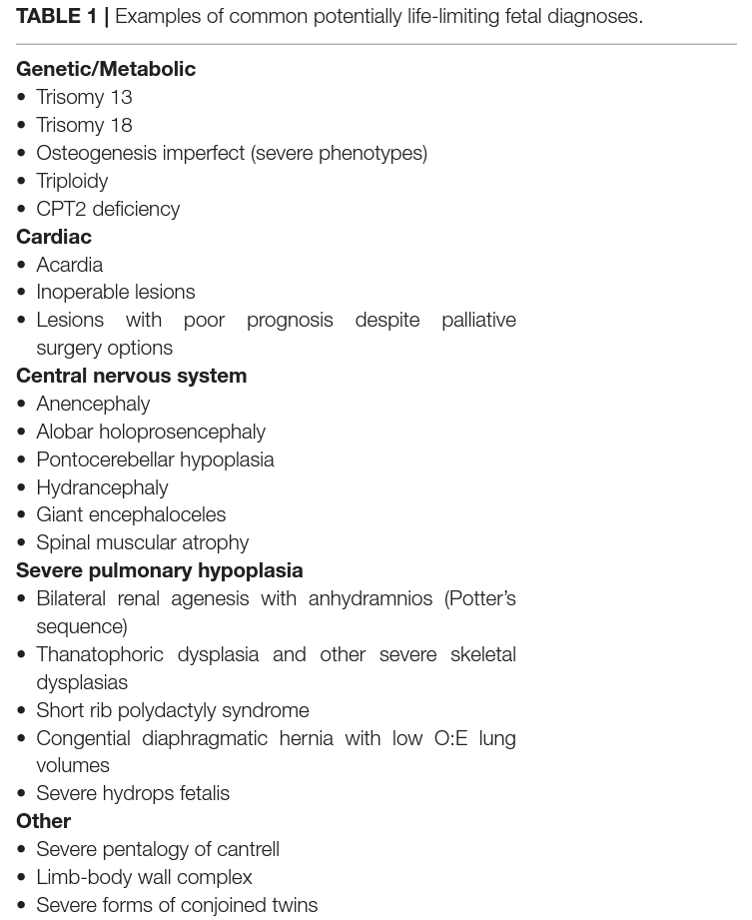
Perinatal Palliative Care
Prevalent conditions that lead to limits on life expectancy (preferred term: life-limiting, not “incompatible with life”)
Goals of authors’ review:
Return decision making to parents
Return control to the family
Allow parents to parent their children

Slide 7
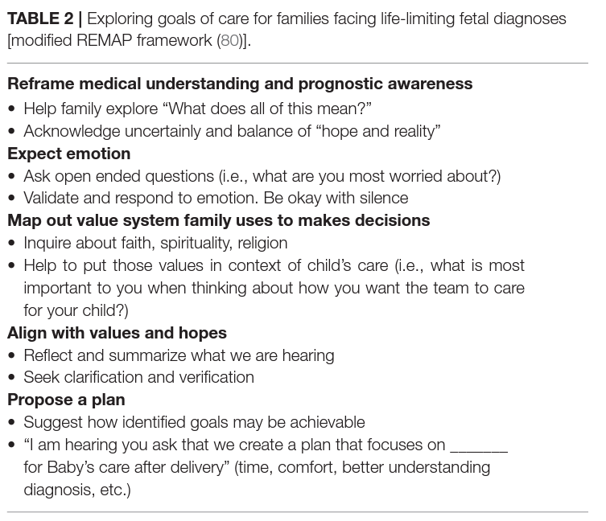
REMAP Framework
Recommended steps for handling PPC goals of care discussion
These authors modified adult palliative care language and planning for PPC

Slide 8

Perinatal Palliative Care Notes
People: Team and family members present, name of the baby(ies), specialists involved
Setting: Timing and reason for the visit
Circumstances: Maternal history and labs, including social history
Counseling: description of anomalies and prognosis, treatment options
Goals of Care: make a comprehensive birth plan
Plan: follow-up, notes on coping, referrals (child life, bereavement, psychology)

Slide 9
Key birth plan details
Names and contact information of parents, support (e.g. family), key care team members (e.g. pediatrician, obstetrician, genetic counselor)
Diagnosis
Wishes for labor and delivery (mode of delivery, monitoring)
Wishes for birth (plan for stillborn baby, plan to delay or modify usual neonatal care, memory-making, child life, spiritual rituals, plans if the baby survives the first day)
Wishes for discharge (end-of-life care at home vs. in hospital, code status, hospice, funeral home)
Wishes for death (funeral home, autopsy, organ donation, transportation of the body)

Slide 10
Limitations
Not a systematic review, may miss some literature
Not a prospective trial or comparison with other styles or with abortion
Are these true weaknesses considering the authors’ goal to educate?

Slide 11
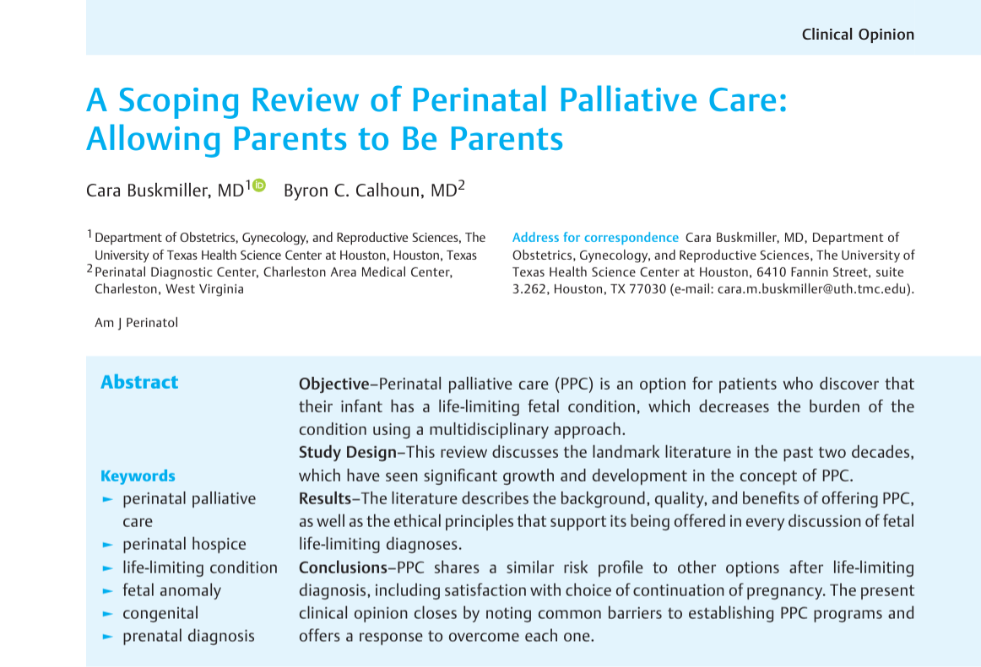
Recent AAPLOG publication

Slide 12
Barriers to Establishing PPC
Providers are more in favor of termination for these conditions, more so than the public or than pregnant women (myth of “sparing” the maternal patient suffering)¹
PPC patients will waste resources, using them when not necessary (e.g. C-section for no neonatal benefit)²
There is no one to insist on PPC being offered, to broaden options and build up patient autonomy ²
1. Hoeldtke NJ, Calhoun BC. Perinatal hospice. Am J Obstet Gynecol 2001
2. Buskmiller CB, Calhoun BC. A Scoping Review of Perinatal Palliative Care. Am J Perinatol 2021

Slide 13
Overcoming Barriers
Regarding provider bias towards abortion:
We have no comparative studies to prove that abortion improves maternal outcomes; all we have is similar rates of regret after PPC and abortion¹
Grief begins at diagnosis and persists for years—abortion has no power to shorten it²
Regarding resources:
Patients should be allowed to utilize obstetric resources regardless of beliefs and diagnosis
ACOG permits elective C-section for no reason, is maternal beneficence to meet a living baby less valid than this?
1. Denney-Koelsch EM, Cote-Arsenault D, eds. Perinatal Palliative Care: A Clinical Guide. 2020
2. Kersting A, Wagner B. Complicated grief after perinatal loss. Dialogues Clin Neurosci 2012

Slide 14
PPC programs need a champion
Regarding “we don’t have enough interest”
There is patient interest, as evidenced by the explosion of over 200 PPC programs across the country in the past 25 years
Where there is patient interest, one provider champion can bring a program to life
Not every PPC program needs every service—start small, build gradually
Buskmiller CB, Calhoun BC. A Scoping Review of Perinatal Palliative Care. Am J Perinatol 2021

Slide 15
Group discussion:
Cases
Questions
Concerns

Slide 16
Objectives
Discuss a review of and expert recommendations about perinatal palliative care
List concrete parts of perinatal palliative care as an evidence-based alternative to termination of pregnancy
Share difficult or helpful clinical cases among attendees

Slide 17
JOURNAL CLUB
Perinatal Palliative Care

Slide 18


Life. It’s why we are here.
AAPLOG.org
Communications @aaplog.org
202-230-0997

