Slide 1
JOURNAL CLUB
Effects of Freezing on Embryos

Slide 2
Objectives
Define “compassionate embryo transfer”
Discuss a survey of members of the Society of Reproductive Endocrinology and Infertility on compassionate embryo transfer
Discuss the way we as pro-life physicians should change our management.

Slide 3
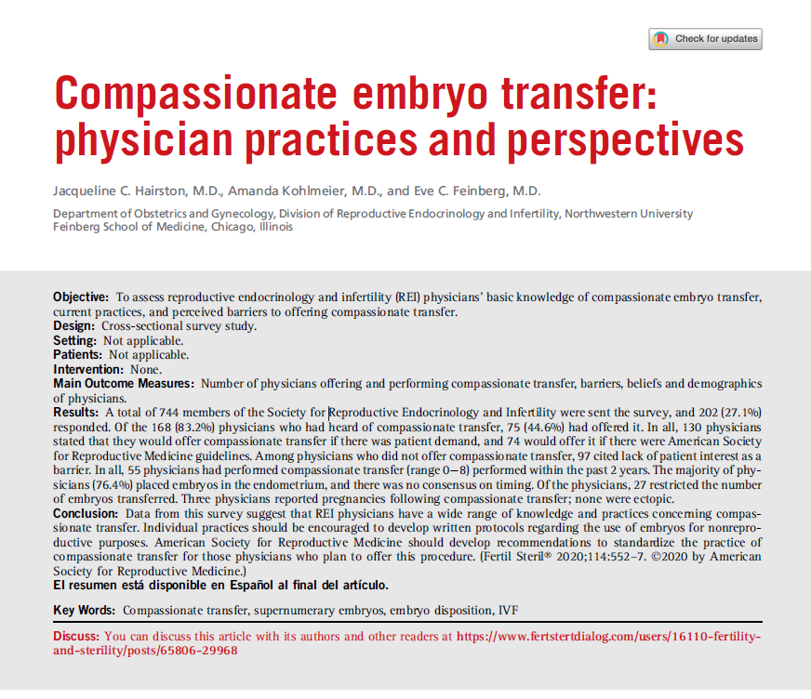

Slide 4

OB/GYNs
Midwives
Family and emergency docs
Maternal-fetal medicine

Slide 5
Definitions
Compassionate transfer: a transfer of potentially viable embryos into the female body in a location or at a time when pregnancy is highly unlikely to occur, and when pregnancy is not the intended outcome.
12% fertility center patients are ‘‘somewhat likely’’ to choose compassionate transfer for their embryos
7% fertility center patients are ‘‘very likely” to choose compassionate transfer for their embryos
Lyerly et al. Fertility patients' views about frozen embryo disposition: results of a multiinstitutional U.S. survey. Fertil Steril 2010;93:499–509

Slide 6
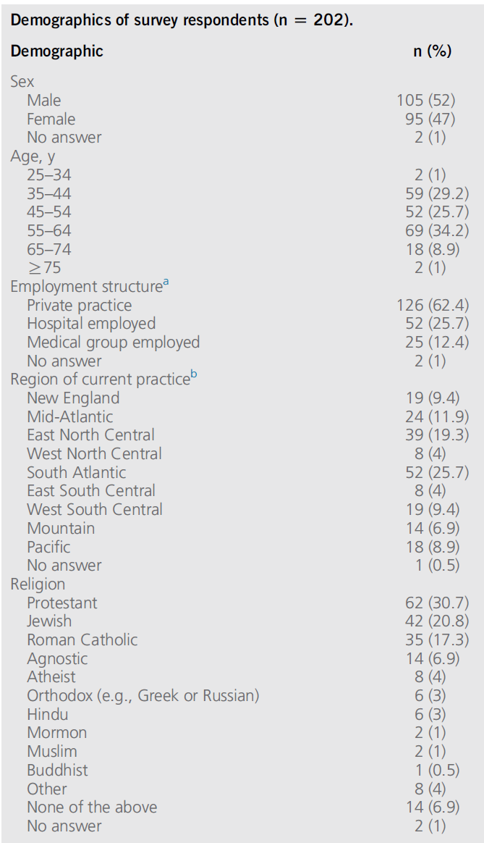
Study design
Cross-sectional survey in 2018
Population: SREI members
Demographics
Have you heard of compassionate transfer?
Have you ever offered compassionate transfer of embryos to a patient?’’
What has kept you from offering a compassionate transfer?
Hairston et aI 2020

Slide 7
Survey Questions
Barriers to offering a compassionate transfer were also assessed, with questions regarding physician personal beliefs about the nature of an embryo such as ‘‘embryos are human life,’’ ‘‘embryos have potential to become human life,’’ or ‘‘embryos are clusters of cells.’’
Factors that might influence a physician to offer a compassionate transfer were also queried with answer options including patient demand, insurance reimbursement, American Society for Reproductive Medicine (ASRM)/Society guidelines, or ‘‘other.’’
Hairston et aI 2020

Slide 8
Results
27% response rate (202/744)
83% knew of compassionate embryo transfer (168/202)
45% had done compassionate embryo transfer (75/202)
2% (4/202) offered it all the time
12% (24/202) offered it sometimes
23% (46/202) offered it once or twice
1 person did not answer this question
Hairston et aI 2020

Slide 9
Results
27% (55/202) had done a compassionate transfer since fellowship (0-8 in past 2 years)
Cost $0-4500
Of these:
49% (27/55) restricted to 1-3 embryos
25% (14/55) transferred all remaining embryos
Remainder allowed patient to decide
3 pregnancies reported
Hairston et aI 2020

Slide 10
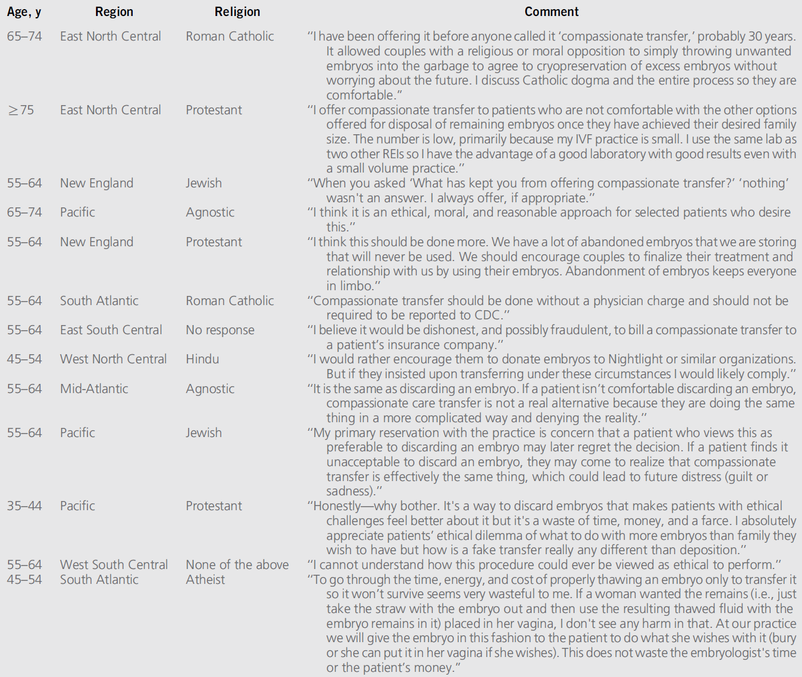

Slide 14
Strengths and Limitations
Strengths
Novel
Diversity of respondents
Addressed demographics, religious and other factors that affect ethical options
Limitations
Low response rate
Self-reported outcomes

Slide 15
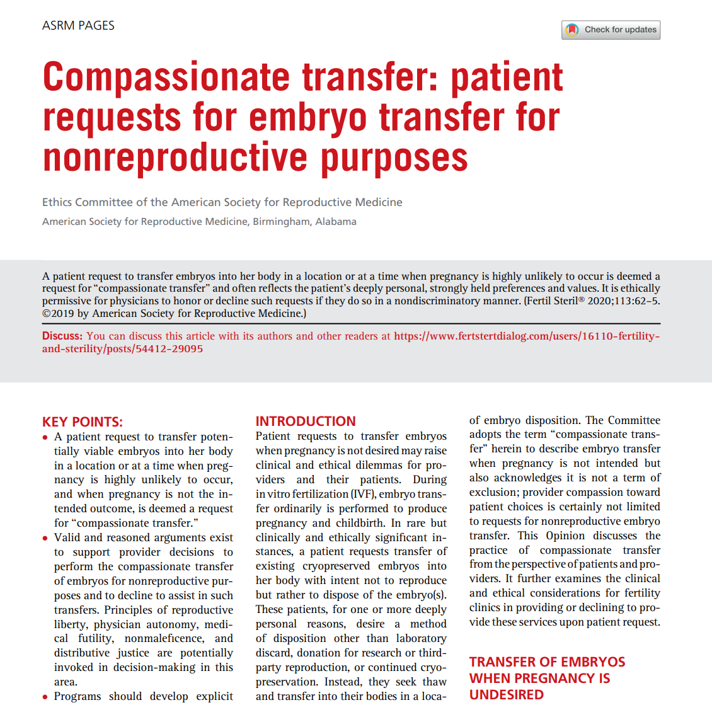

Slide 16
Ethical foundation
Reproductive liberty:
“[P]rotects against outside interference with patient control over reproductive decision-making”
“[H]arms that result from infringement on this patient choice, whether …imposed by providers, the state, or other third parties”
Patient autonomy
Beneficence
Nonmaleficence
Distributive justice

Slide 17
Ethical foundation
Physician autonomy: allows to decline patient’s decision “Physicians are not obligated to meet every patient request, particularly when treatment is futile or highly unlikely to engender any medical benefit”
Medical futility “[E]thical misgivings about performing a procedure that has no medical benefit, while at the same time requiring additional patient financial outlay because the procedure is not eligible for insurance coverage”

Slide 18
“Single males or same-sex male couples who secure embryos for reproduction have no opportunity to seek embryo demise in the same manner as female patients, that is within their body. The Committee believes that enlisting a woman for this purpose exceeds the ethical parameters governing collaborative reproduction, as no reproduction is intended and no benefit to her can result. While single males or same-sex male couples may seek compassionate transfer for reasons aligned with those expressed by female patients, the risk/benefit ratio in third-party embryo transfer for nonreproductive purposes positions it outside the scope of ethical justification.”

Slide 19
“Single males or same-sex male couples who secure embryos for reproduction have no opportunity to seek embryo demise in the same manner as female patients, that is within their body. The Committee believes that enlisting a woman for this purpose exceeds the ethical parameters governing collaborative reproduction, as no reproduction is intended and no benefit to her can result. While single males or same-sex male couples may seek compassionate transfer for reasons aligned with those expressed by female patients, the risk/benefit ratio in third-party embryo transfer for nonreproductive purposes positions it outside the scope of ethical justification.”

Slide 20
Objectives
Define “compassionate embryo transfer”
Discuss a survey of members of the Society of Reproductive Endocrinology and Infertility on compassionate embryo transfer
Discuss the way we as pro-life physicians should change our management.

Slide 21
JOURNAL CLUB
AAPLOG

Slide 22


Life. It’s why we are here.
AAPLOG.org
Communications @aaplog.org
202-230-0997

Slide 23
Prior Literature
Morphokinetics evidence = nu
Refs

Slide 24
Prior Literature
bullets
Refs

