Slide 1
JOURNAL CLUB
Post-Roe Update and
Ending Pregnancy Ethically

Slide 2

OB/GYNs
Midwives
Family and emergency docs
Maternal-fetal medicine

Slide 3
Objectives
Review a report from the Society of Family Planning on abortion after Dobbs
Discuss cases from the community where care was less safe out of fear of the law, or because of laws
Review AAPLOG’s approach to safe maternal care without resorting to abortion
Define what abortion is, and what it isn’t

Slide 4
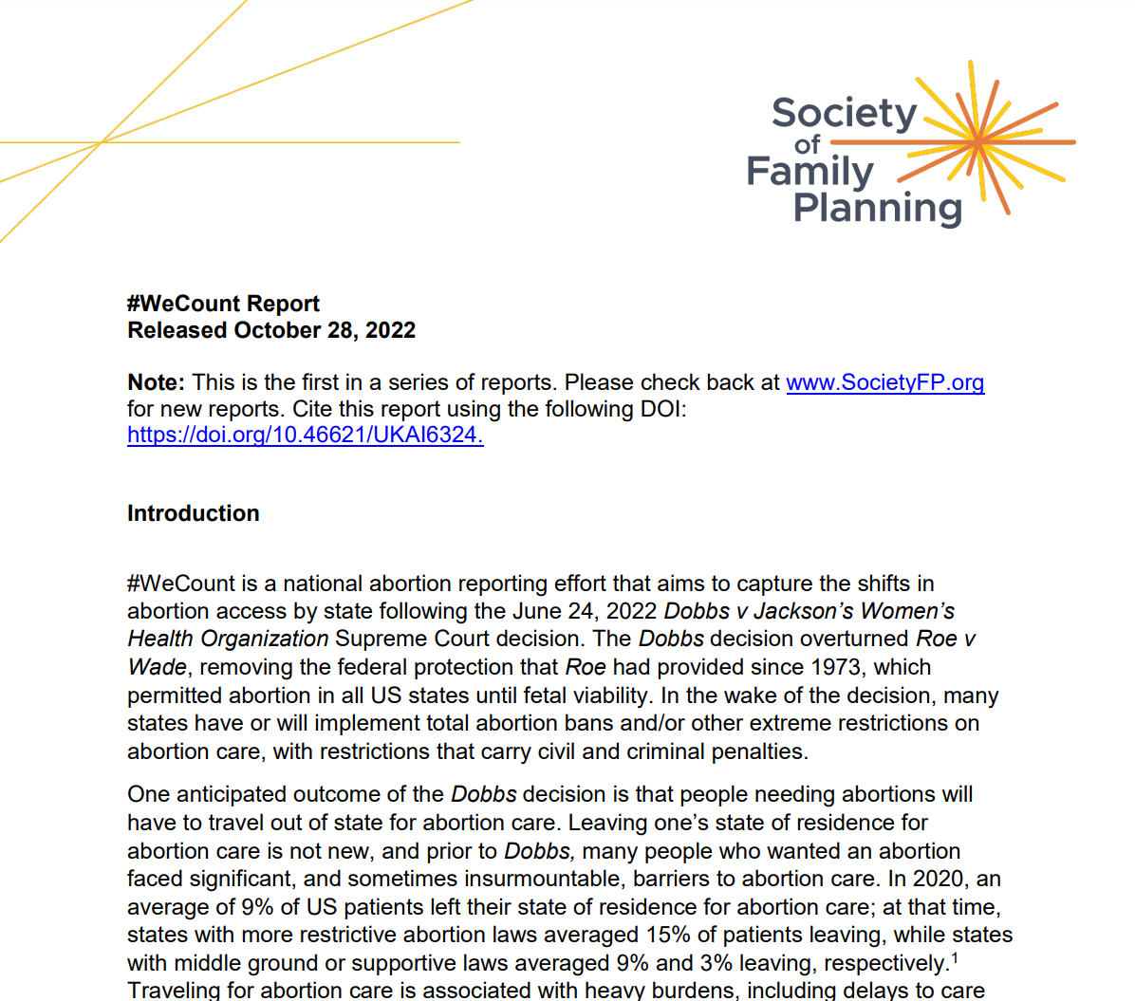

Slide 5
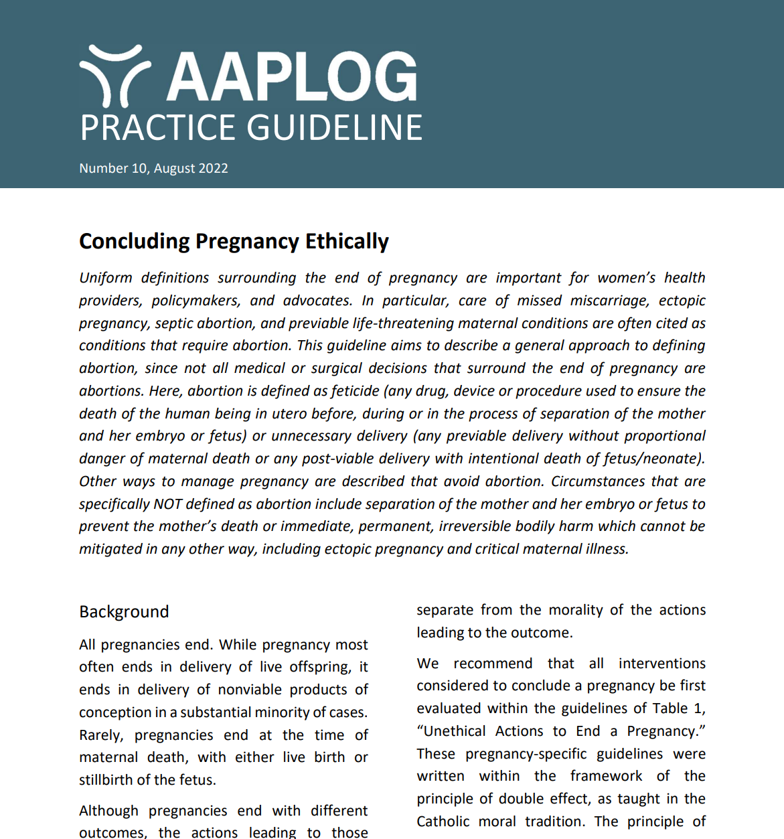

Slide 6
Background
Society for Family Planning is an organization made up of physicians and other clinicians (e.g. midwives, midlevels) who do medication abortion, MVA, or surgical abortion, whether in the first trimester or later
SFP has developed a complex family planning fellowship for training in later D&Es as these become rarer and training in them becomes absent from most OB/GYN residencies (i.e. not needed to train the obstetrician in these procedures as not common/not essential)
SFP began a project to collect the changes in abortion provision among clinicians as the legislative environment began to broil in 2022-23
  Abortions were on the rise globally and in the U.S.
  Abortion numbers are lower in the summer, which is when Dobbs happened (June 2022)

Slide 7
Study design
Authors (SFP) “developed a database of all clinics, private medical offices, hospitals, and virtual-only providers in the US known to offer abortion care in early 2022”
  Abortion Facility Database from Advancing New Standards in Reproductive Health at University of California, San Francisco +
  Providers who were participating in the Ryan Training program +
  Providers who were participating in the Complex Family Planning Fellowship +
  Searching on Abortion Finder +
  Contacts within the Society of Family Planning +
  Contacts within the Society for Maternal-Fetal Medicine
#WeCount Report, DOI 10.46621/UKAI6324

Slide 8
Study design
79% of all identified providers agreed to participate (estimated 82% of all abortions provided)
Missing April data: “we estimated the number of abortions by state using several information sources including the Guttmacher Institute, state health departments, news articles, contacts known to the missing clinics, and knowledge of the abortion volumes by state.”
If the number of abortions for a given state was less than ten for a single month, we rounded the number of abortions up to ten
#WeCount Report, DOI 10.46621/UKAI6324

Slide 9
Study design
Change in provision of estimated abortions provided by a clinician was reported for each US census regions
Legislation in each state was classified as “abortion is banned,” “abortion access is restricted,” or “abortion access is legal with few[/no] restrictions”
Legislation assignments were based on reporting by the New York Times
Calculated number of abortions per 1000 women
Exempt from review by Advarra IRB (independent IRB)
Sponsored by SFP and shaped by its Research Steering Committee
#WeCount Report, DOI 10.46621/UKAI6324

Slide 10
Results
100% of identified abortion providers in 29 states (56.8% complete data across the country including D.C.)
The estimated number of abortions provided by a clinician decreased from 85,020 abortions in April 2022, before the decision, to 79,620 abortions in August 2022 (down 6%)
Since Dobbs decision, there were 5,270 fewer abortions in July and 5,400 fewer in August compared to April (10,670 in 2 months)
The national abortion rate decreased from 14 per 1,000 women of reproductive age1 in April to 13 per 1,000 in August.
#WeCount Report, DOI 10.46621/UKAI6324

Slide 11
Results
Abortions provided by virtual-only clinics increased from 2,830 in April 2022 (3% of total abortions), before the decision, to 3,780 in August 2022 (4.7% of all abortions, abortions provided from virtual-only services up 33%)
The estimated number of abortions provided by a clinician in states that significantly regulate abortion (e.g. after 6-weeks) decreased from 8,500 abortions in April to 460 in August 2022.
In states with significant regulation, there were 7,870 fewer abortions in July and 8,040 fewer in August (total of 15,910 fewer abortions, down 95%)
Questions we should ask: What are those residual 460/5% of abortions??
#WeCount Report, DOI 10.46621/UKAI6324

Slide 12
Results
In states with some regulation, the estimated number of abortions provided by a clinician decreased from 13,850 abortions in April to 9,390 abortions in August 2022.
Since Dobbs, in states with some regulation, there were 2,160 fewer abortions in July and 4,460 fewer in August (total of 6,620 fewer abortions, down 32%).
Questions we should ask: What are those residual 9390/68% of abortions, and why do states with significant regulation think they can do fewer?
#WeCount Report, DOI 10.46621/UKAI6324

Slide 13
Results
In states that are not regulating abortion at all or with minimal regulation, abortions increased from 62,600 abortions in April to 69,740 abortions in August 2022.
Since Dobbs, there were 4,840 more abortions in July and 7,140 more in August (11,980 excess abortions, up 11%)
Questions we should ask: 11.98k – (6.62k + 15.91k) = 10.55k
We are doing without 10,550 abortions. How are we doing? Are women safe? Are communities meeting their needs?
#WeCount Report, DOI 10.46621/UKAI6324

Slide 14
Results
States with the largest increase in estimated abortion provided by a clinician:
  North Carolina (37%)
  Kansas (36%)
  Colorado (33%)
  Illinois (28%)
Notable exceptions
  California (1% increase, 17k-18k/mo)
  Texas (2770 from October regulation to 10/mo)
  Oklahoma (510 from May regulation to 10/mo)
#WeCount Report, DOI 10.46621/UKAI6324

Slide 15
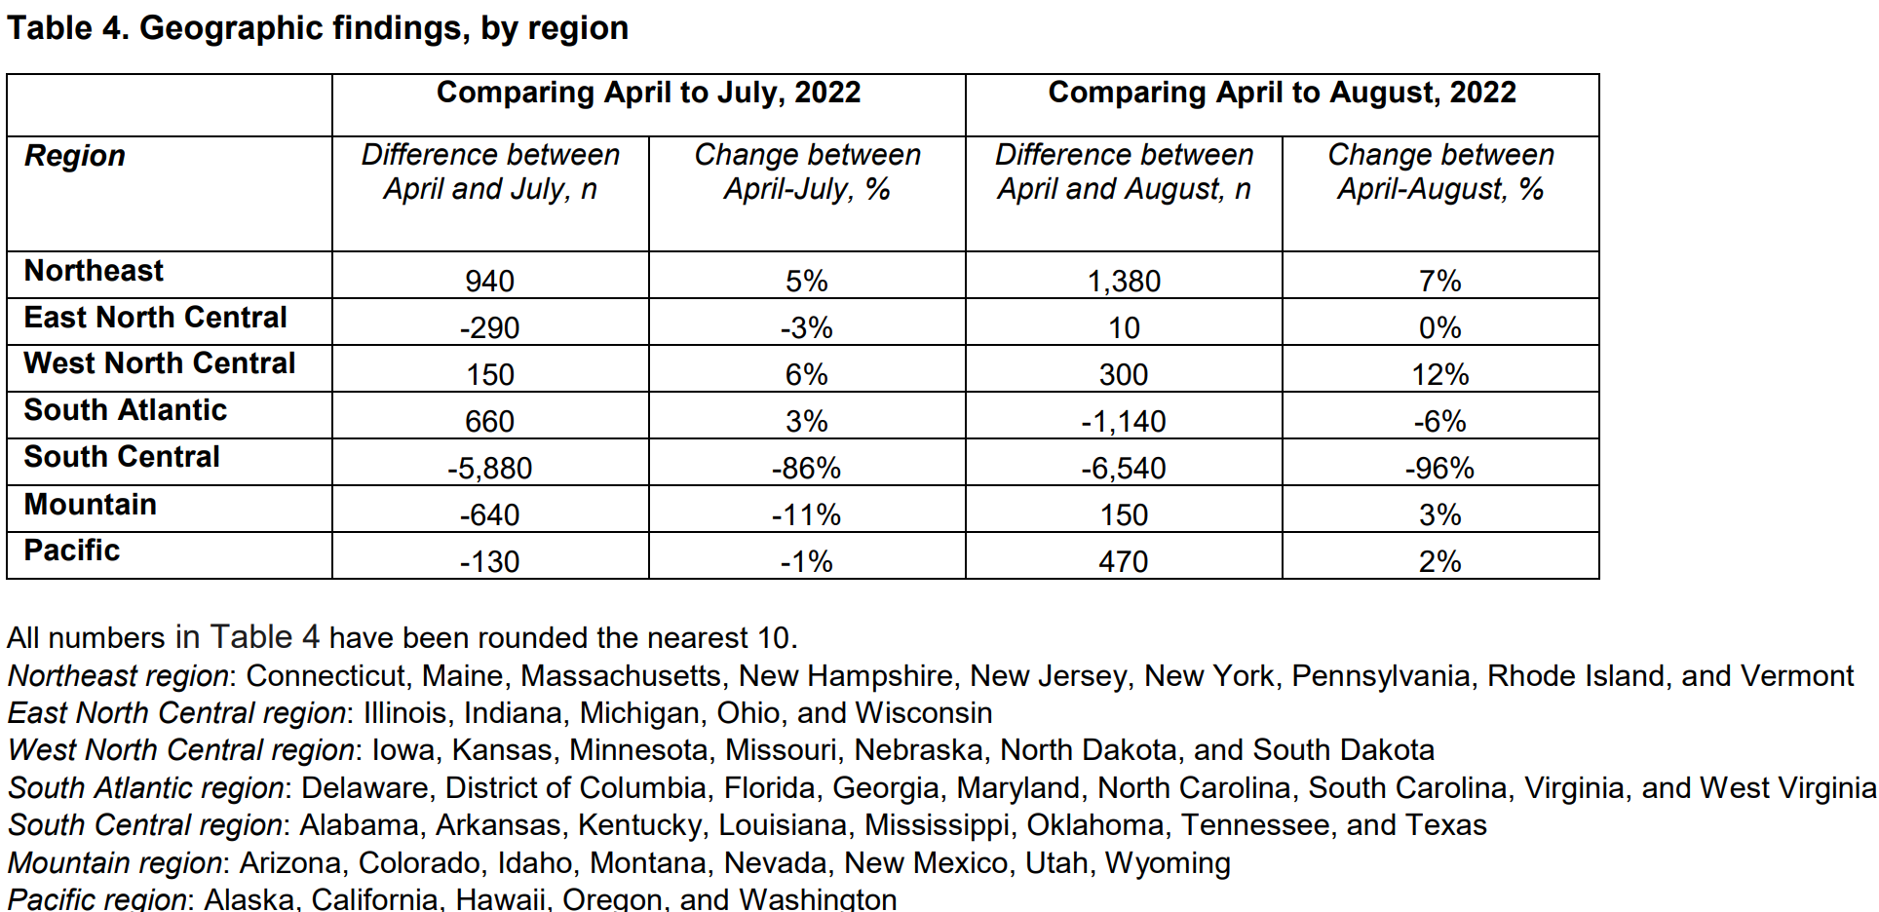
#WeCount Report, DOI 10.46621/UKAI6324
Notes:
Abortions slightly increased (7%) in the Northeast (NY, NJ, PA, VA, CT, MA, ME, NH, RI)
Northern midwest almost completely unchanged (11480 to 11490; IL, IN, MI, OH, WI); there were shifts within the region
The western Midwest experienced a modest increase (12%, IO, KS, MN, MO, NE, ND, SD)
The South Atlantic (D.C., DE, FL, GA, MA, NC, SC, VA, WV) dropped 6%
Abortions in the southwest increased slightly (6%, AZ, CO, ID, MT, NE, NM, UT, WY)
The Pacific coast (CA, HI, OR, WA, AL) increased slightly (2%)
South (AL, AR, KY, LA, MS, OK, TN, TX) decreased by 96%, driving most of the rest of the large numbers in the report

Slide 16
Results
Abortion volatility example based on partisan court: Arizona
Graph approximated from data reported in the #WeCount Report, DOI 10.46621/UKAI6324

Slide 17
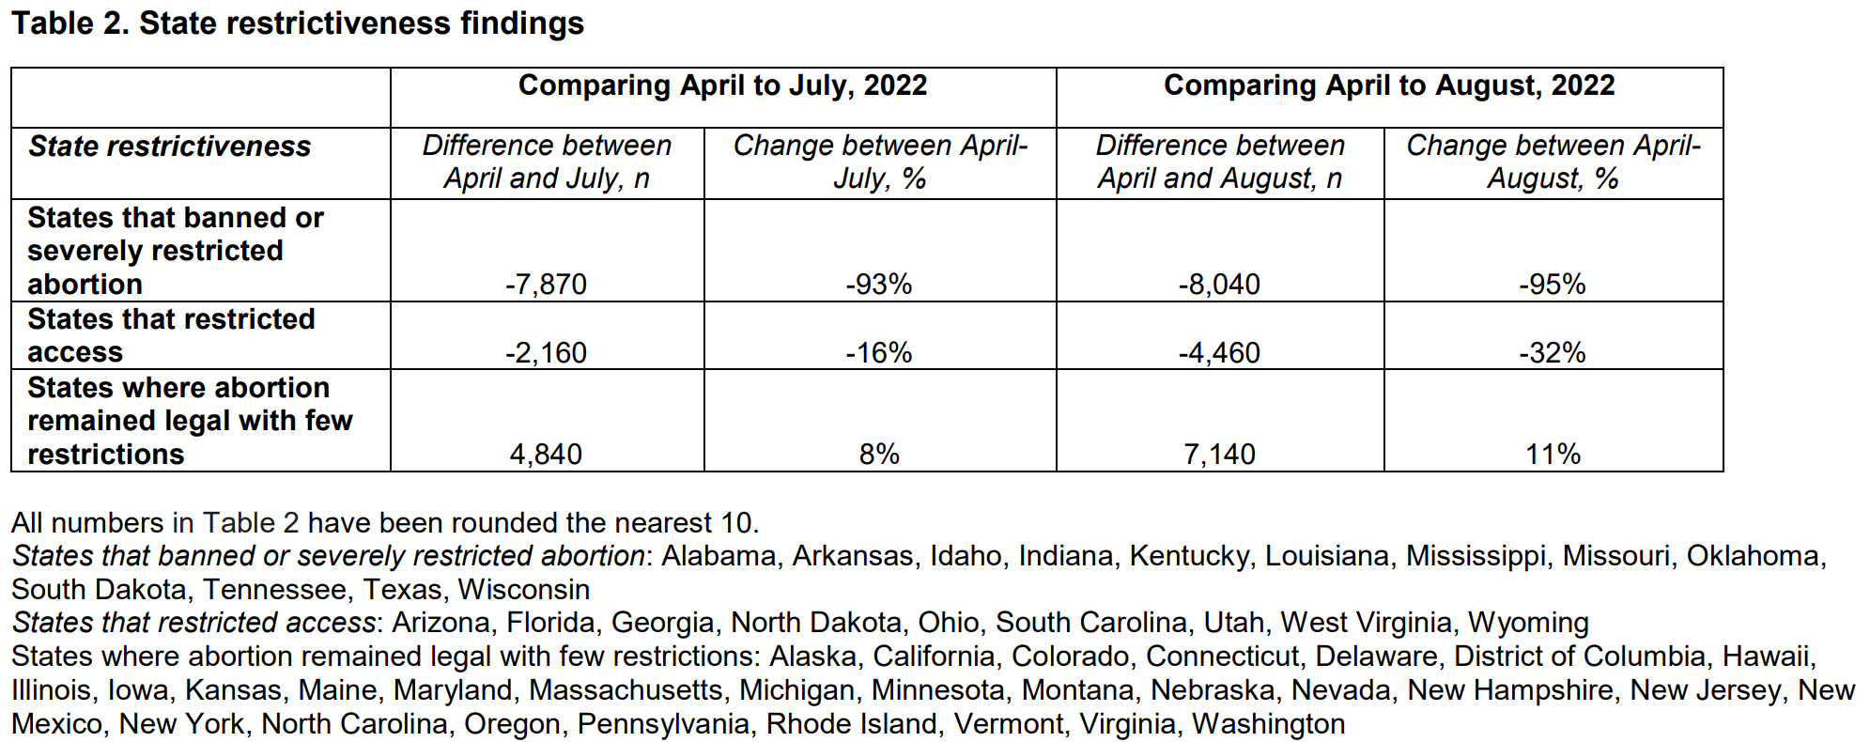
#WeCount Report, DOI 10.46621/UKAI6324

Slide 18
Results
The decline in abortions in states with significant regulation deepened (9990 to 12380) between July and August after Dobbs, suggesting against a kind of “rebound” effect as clinicians and policymakers understood their laws
“People of color and people working to make ends meet have been impacted the most” (the South…but this was not a patient-level study)
#WeCount Report, DOI 10.46621/UKAI6324

Slide 19
Strengths
First of its kind but not alone (CDC will collect this data as well although report it more slowly)
Probably the only organization that could do this in a lean way, without sampling much more widely (e.g. sending out survey to every single ABOG diplomate)

Slide 20
Limitations
56.8% complete response rate of the country, estimated 80% of abortions done
N from April pulled from “news articles, contacts known to the missing clinics, and knowledge of the abortion volumes by state” – we wrote down what we thought
Near-convenience sample of clinics, private offices, hospitals, and virtual-only providers (“no test” medication abortion)
No self-managed abortion
No different reporting for “no-test” medication abortion (virtual)
No definition of what involves “virtual” (many different definitions in literature)
No clarity on whether indicated previable induction is “abortion” or not

Slide 21
Conclusions
Clinician-associated abortion is declining
Virtual-only is not defined
Self-managed abortion is rising but not measured
Definition of abortion is not provided
Incomplete data from April was discovered in questionable ways, and all comparisons are compared to April
“Garbage in, garbage out”

Slide 22
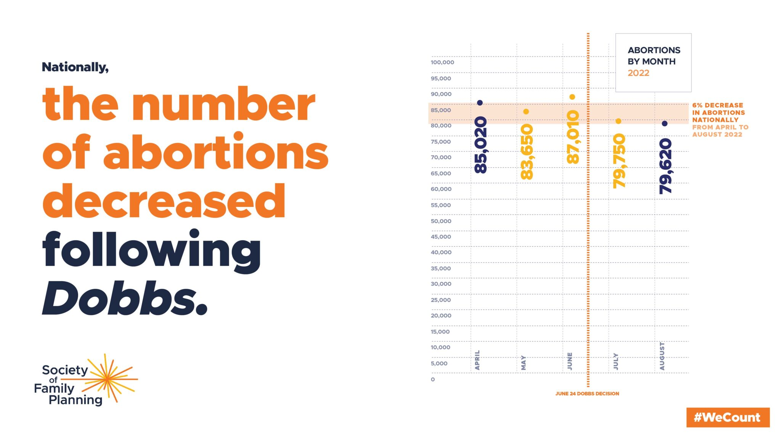

Slide 23
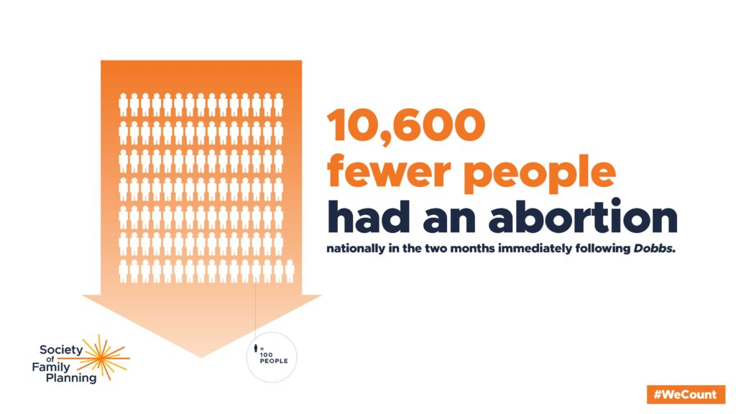

Slide 24
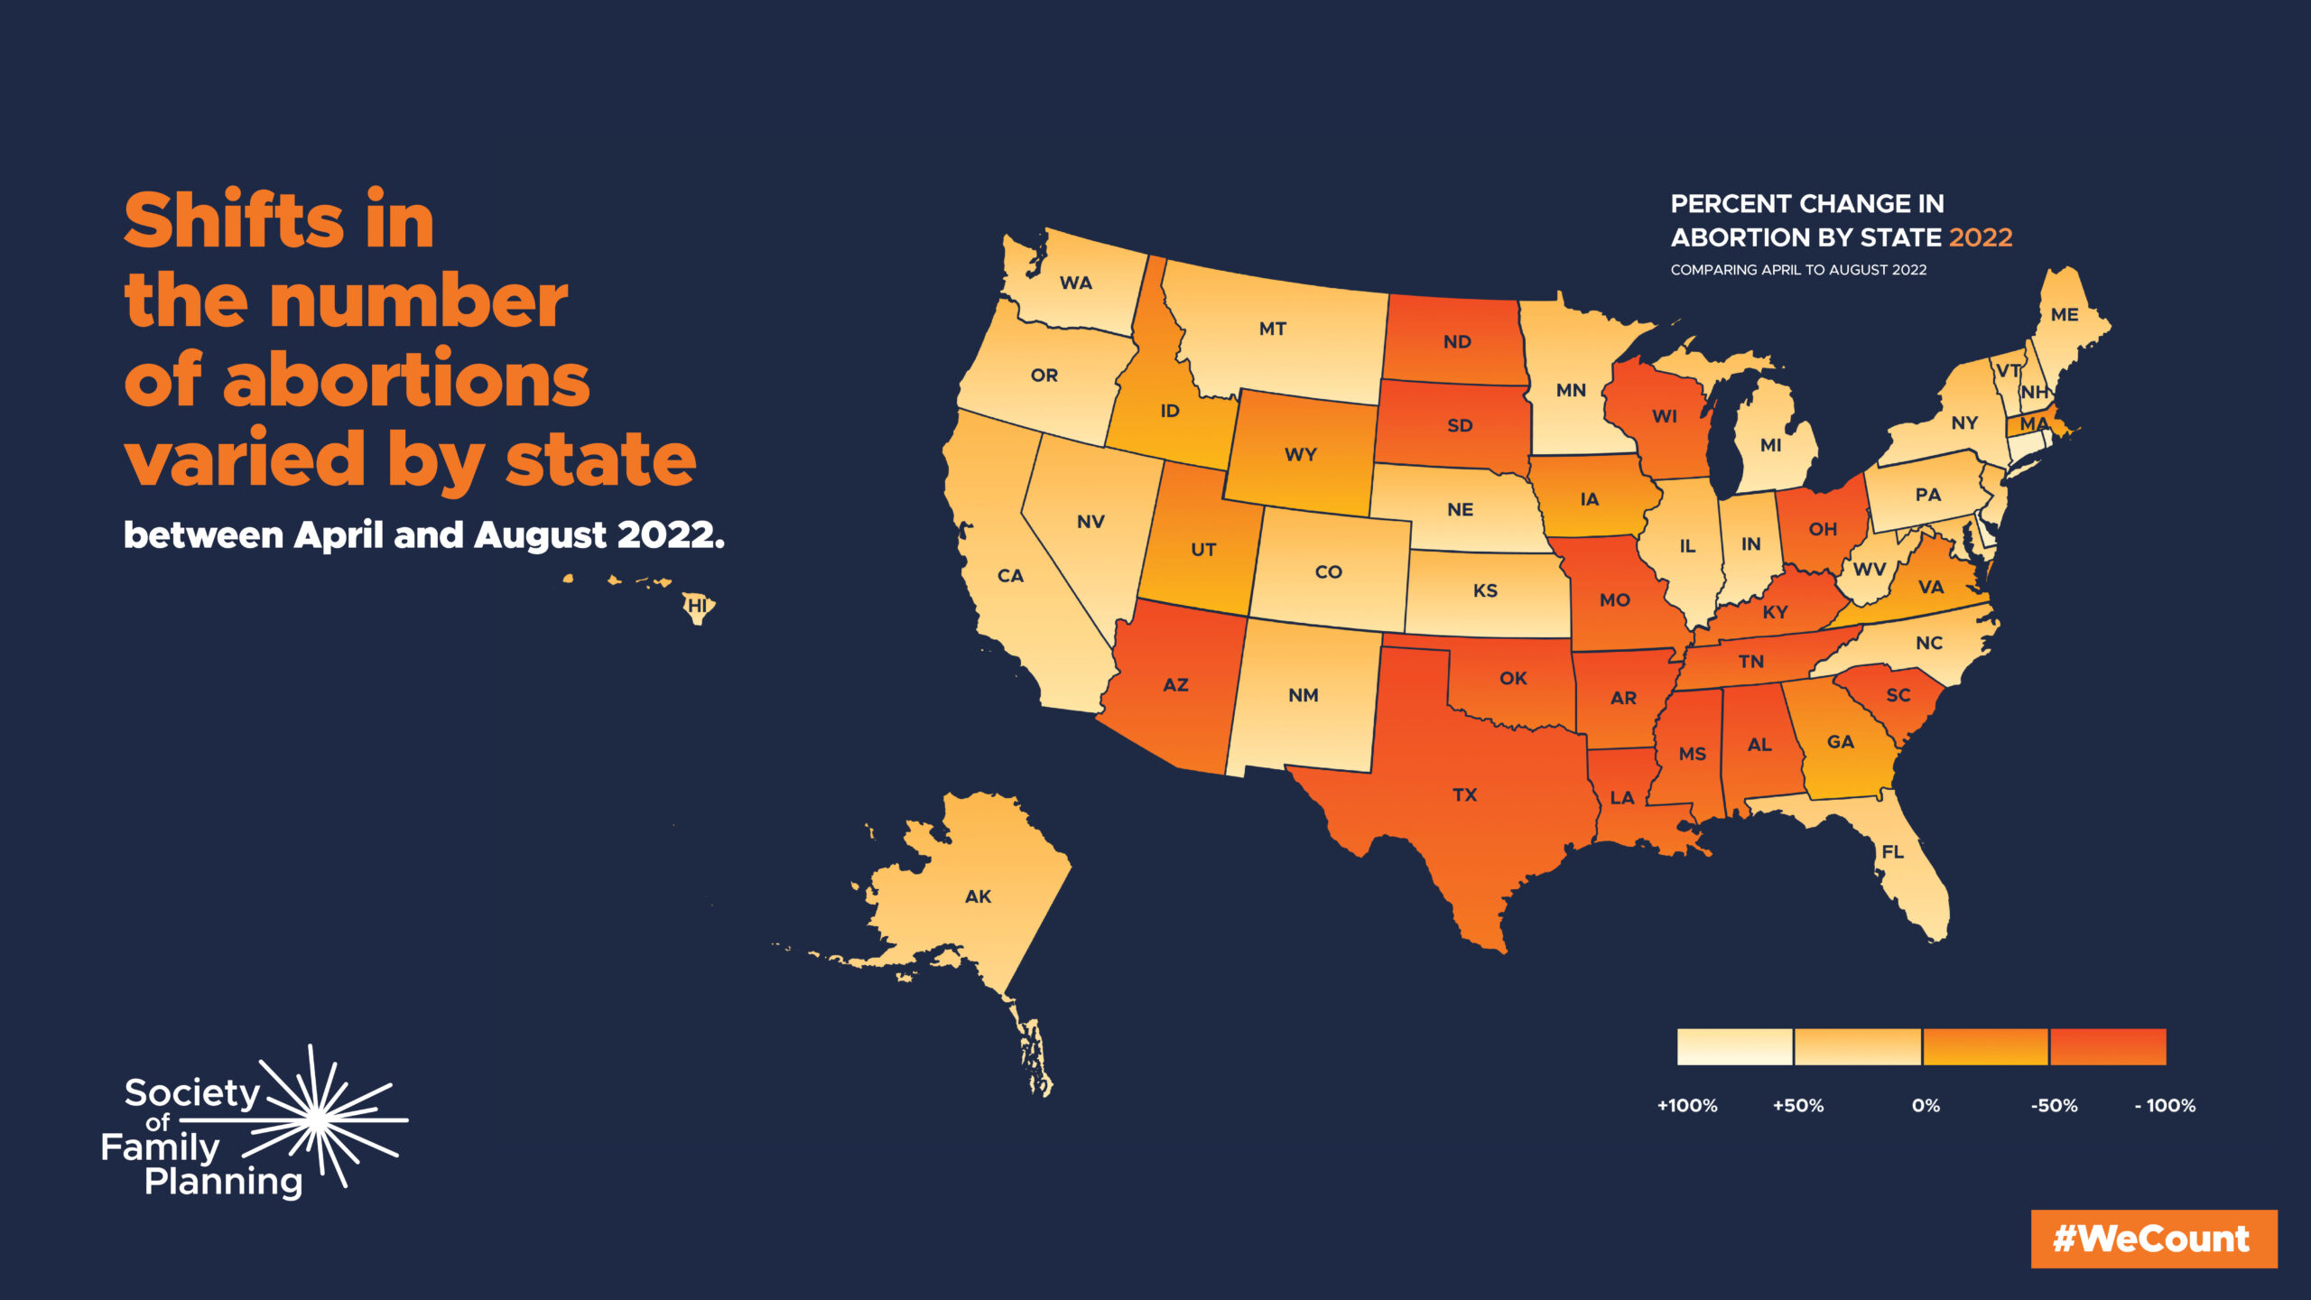

Slide 25
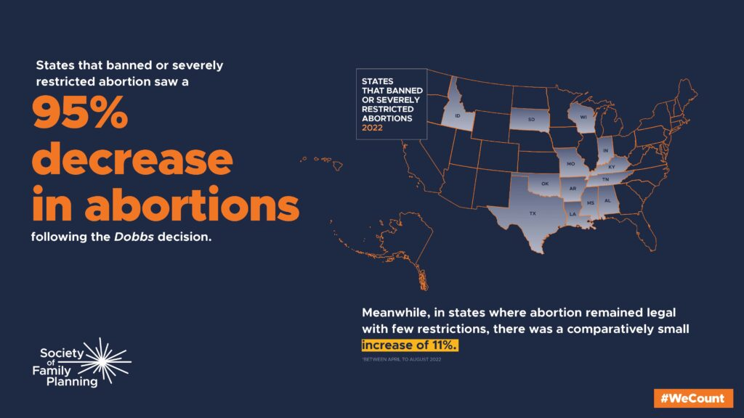

Slide 26
Talking Points
Women traveled out of state for abortion even before Dobbs; 3% of women traveled out of states with no regulation pre-Dobbs, so this is the “floor” which we can expect for states with significant regulation (not zero).
“[T]hose who are unable to overcome these burdens [barriers] are left to carry pregnancy to term”
They are left to carry pregnancy to its appropriate gestational age at delivery, whether pre- or post-viability, and pre- or post-term.
We are doing without 10,550 abortions (about 5,000 per month) because of local regulations (not because of Dobbs) which constituents and local lawmakers introduced.
Focus less on # of abortions and more on maternal safety—what do women need?

Slide 27
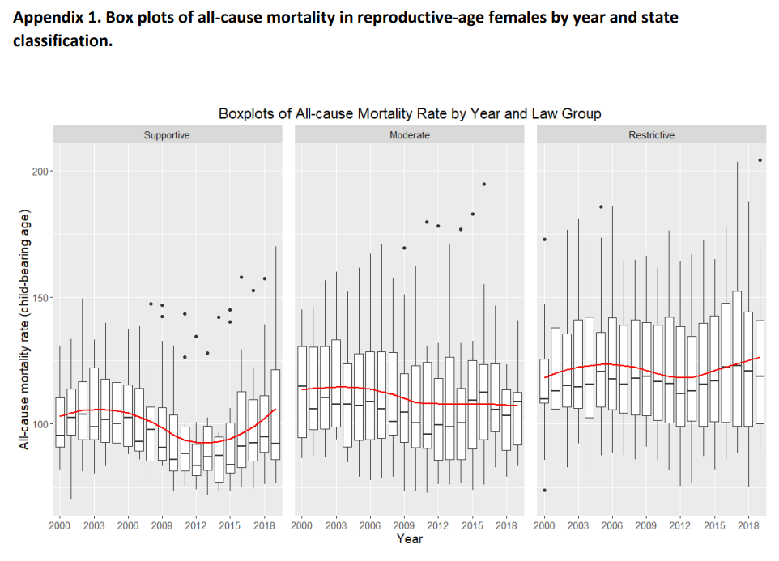
Contextualizing in the Literature
Harper et al. All-cause mortality in reproductive age females by state: an analysis of the effects of abortion legislation. Obstet Gynecol 2023;141.
Concluded that maternal mortality increased in states associated with more abortion regulation, although all-cause mortality increased more steeply in abortion-supportive states and maternal mortality was (1) plateauing in regulation-states and (2) is defined in problematic and heterogenous ways
Notes:
Harper LM, Leach J, Robbins L, Blanchard C, Metz TD, Mazzoni S, et al. All-cause mortality in reproductive age females by state: an analysis of the effects of abortion legislation. Obstet Gynecol 2023;141. The authors provided this information as a supplement to their article. ©2023 The American College of Obstetricians and Gynecologists.
https://cdn-links.lww.com/permalink/aog/c/aog_141_2_2022_10_25_harper_22-1654_sdc1.pdf

Slide 28
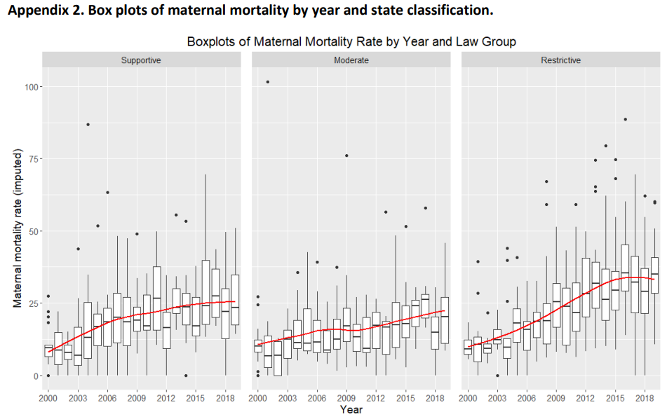
Contextualizing in the Literature

Slide 29
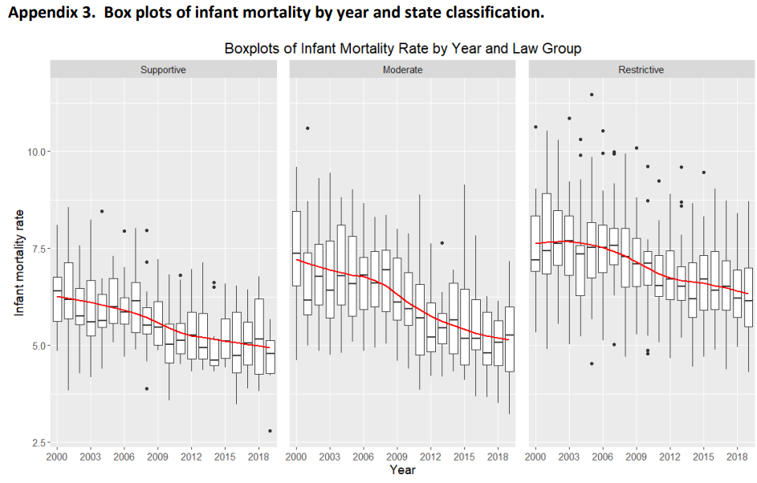

Slide 30
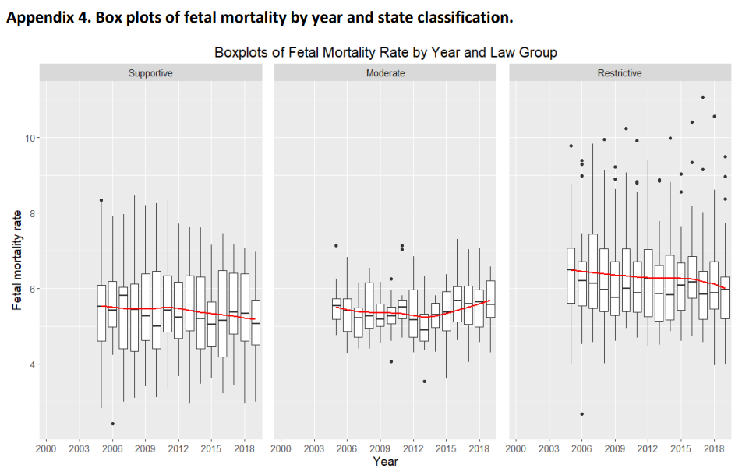

Slide 32
What IS abortion?
AAPLOG is not in favor of forcibly continuing all pregnancies to term or to the point of maternal death
AAPLOG is not in favor of preferring the fetal life over the mother’s (they are two patients, linked together, one of whom depends on the other but is no more worthy/important than the other)
AAPLOG permits bringing about the end of pregnancy when maternal life/limb/organ function requires it
Abortion: intentional feticide, dismemberment unto death, induction of labor in the absence of a proportional maternal reason (e.g. for the reason of not having a living person with a disability)
Not abortion: induction of labor even pre-viability, C-section even pre-viability, D&C of presenting previa or mole, D&C or D&E after fetal death

Slide 33
Objectives
Review a report from the Society of Family Planning on abortion after Dobbs
Discuss cases from the community where care was less safe out of fear of the law, or because of laws
Review AAPLOG’s approach to safe maternal care without resorting to abortion
Define what abortion is, and what it isn’t

Slide 34
JOURNAL CLUB
Discussion – Not Recorded

Slide 35


Life. It’s why we are here.
AAPLOG.org
Communications @aaplog.org
202-230-0997

